Slide 1
Hawaii Wildfires - 2023
Assessment Period: August 8-18, 2023
Publication Date: August 18, 2023
USDA NASS
Disaster Monitoring Team

Slide 2
Event Summary
Location: Hawaii, U.S.
Event: Hawaii Wildfires (https://gdacs.org/Wildfires/report.aspx?eventtype=WF&eventid=1016286&episodeid=1)
  A series of wildfires broke out in the state of Hawaii, primarily on the island of Maui.
  Due partly to Hurricane Dora south of Hawaii and to dry, gusty wind conditions created by a high-pressure area north of Hawaii.
Timeframe: August 8-10, 2023
  August 8, 2023: Emergency declaration, activation of the Hawaii National Guard and Hawaii Emergency Management Agency
  August 9: Hawaii issued a state of emergency for entire state
  August 10: Federal major Disaster Declaration

Slide 3
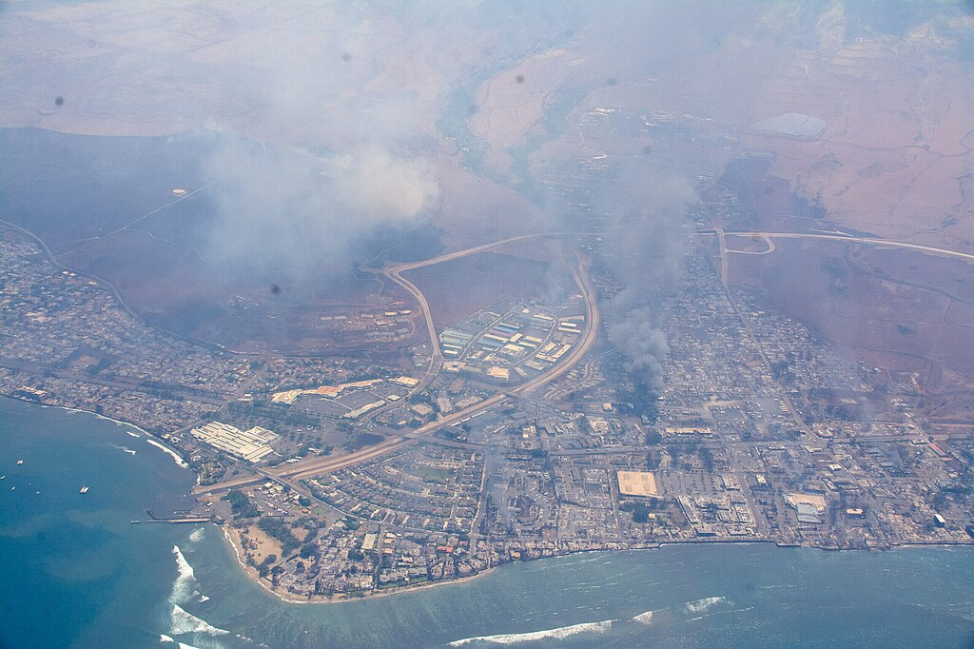
Aerial view of Lahaina on the island of Maui on August 8 (Photo Credit: Civil Air Patrol).

Slide 4
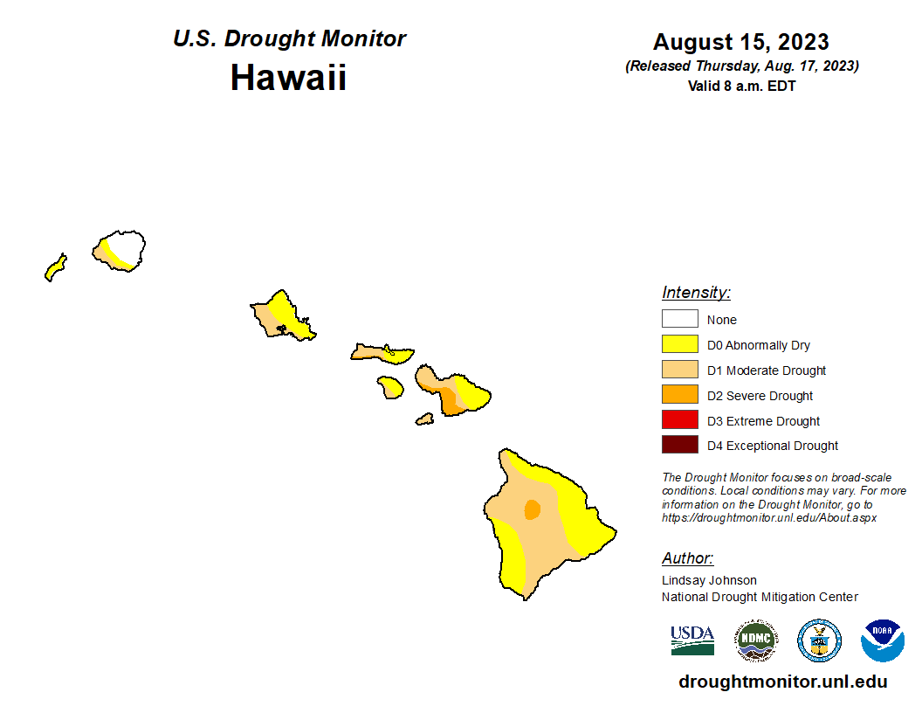
Drought Conditions

Slide 5
2023-08-03
2023-08-08
Hawaii, HI
Pre- and Post- Event Sentinel-2 Imagery

Slide 6
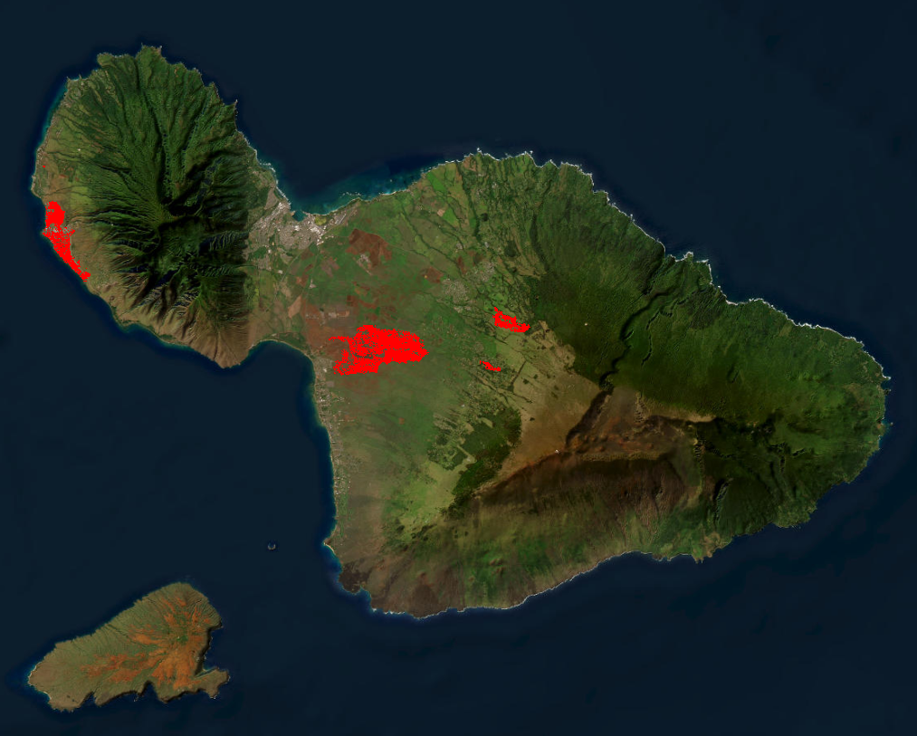
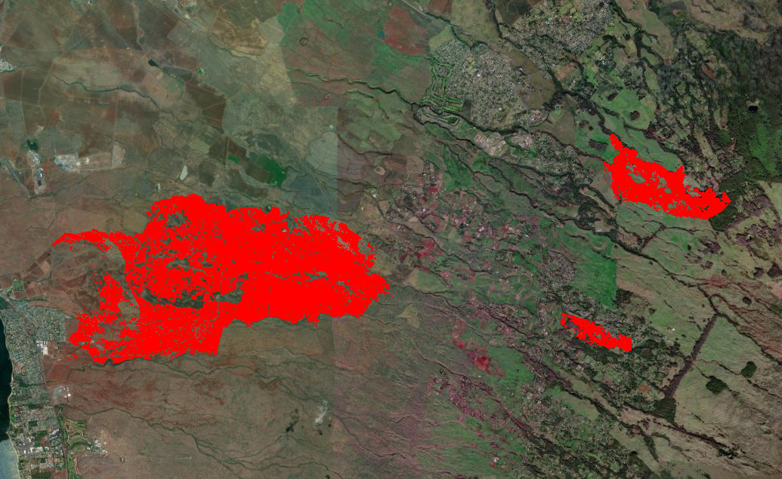
Wildfires
Maui, HI
Fire extents derived from Sentinel-2 Normalized Burn Ratio (NBR), August 8-18, 2023.

Slide 7
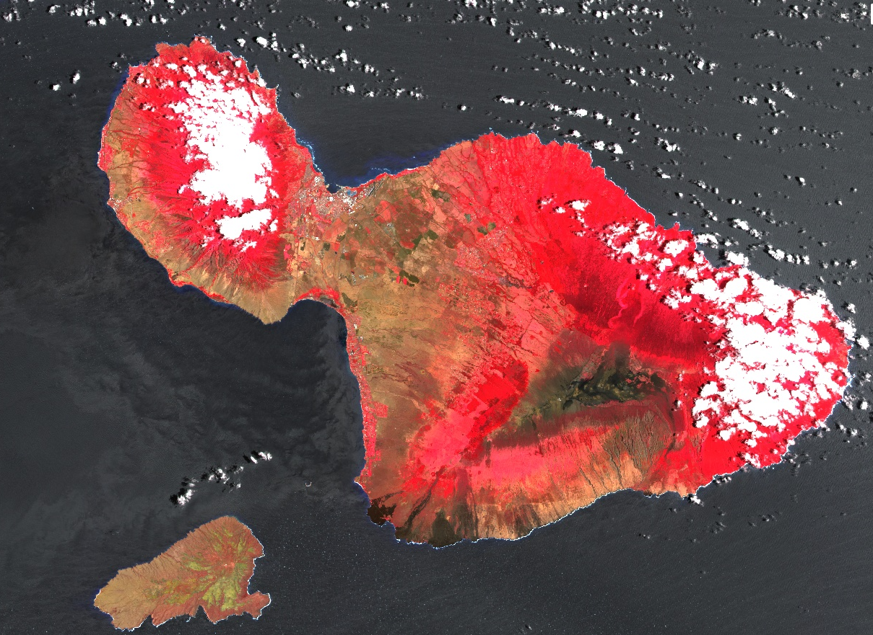
Pre-Event Imagery
Maui, HI, August 8, 2023
Sentinel-2 Imagery

Slide 8
Post-Event Imagery
Maui, HI, August 13, 2023
Sentinel-2 Imagery

Slide 9
Post-Event Imagery
Maui, HI, August 15, 2023
Landsat 9 Imagery

Slide 10
Post-Event Imagery
Maui, HI, August 18, 2023
Sentinel-2 Imagery

Slide 11
Sentinel-2 2023-08-08
Sentinel-2 2023-08-13
Landsat 9 2023-08-15
Sentinel-2 2023-08-18
Maui, HI
Pre- and Post- Event Sentinel-2 Imagery

Slide 12
2023-07-24
2023-08-03
2023-08-13
Maui, HI
Pre- and Post- Event Sentinel-2 Imagery

Slide 13
Maui, HI
Pre- and Post- Event Sentinel-2 Imagery
Banana Fields
2023 Airbus CNES Maxar
2023-08-08
2023-08-13

Slide 14

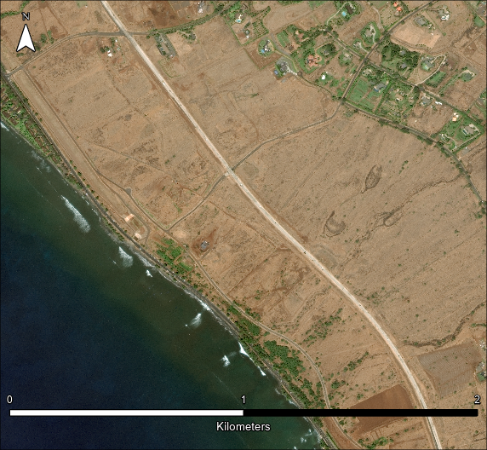
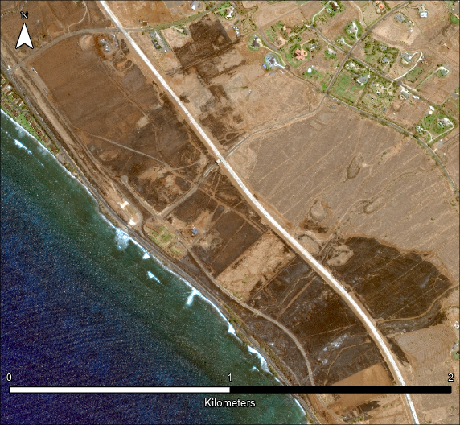
Launiupoko, Maui, HI: Assessed Fire Damage to Pastures/Rangelands
August 2, 2023
August 12, 2023
WorldView-3 © 2023 Maxar
WorldView-2 © 2023 Maxar

Slide 15

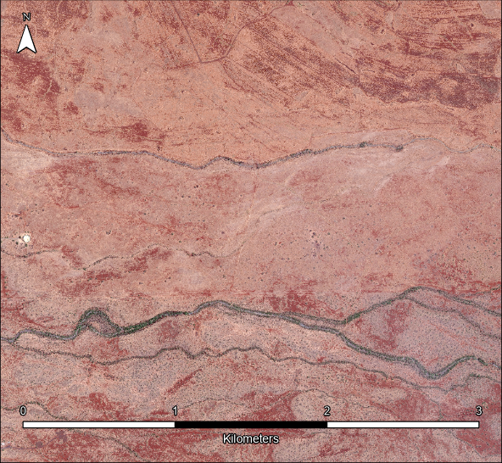
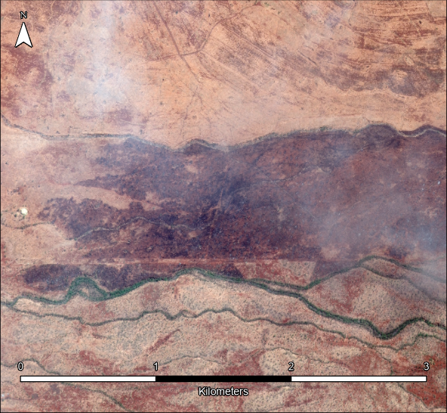
Kihei, Maui, HI: Assessed Fire Damage to Pastures/Rangelands
July 29, 2023
August 9, 2023
GeoEye-1 © 2023 Maxar
GeoEye-1 © 2023 Maxar

Slide 16
Land use and land cover product used for impact assessment
The land use and land cover product used for the impact assessment was created by integrating ESA Sentinel-2 10m Land Use/Land Cover 2022 (https://www.arcgis.com/home/item.html?id=cfcb7609de5f478eb7666240902d4d3d) with the 2020 Hawaii Statewide Agricultural Land Use Baseline data (https://planning.hawaii.gov/gis/download-gis-data-expanded/).
Legend

Slide 17
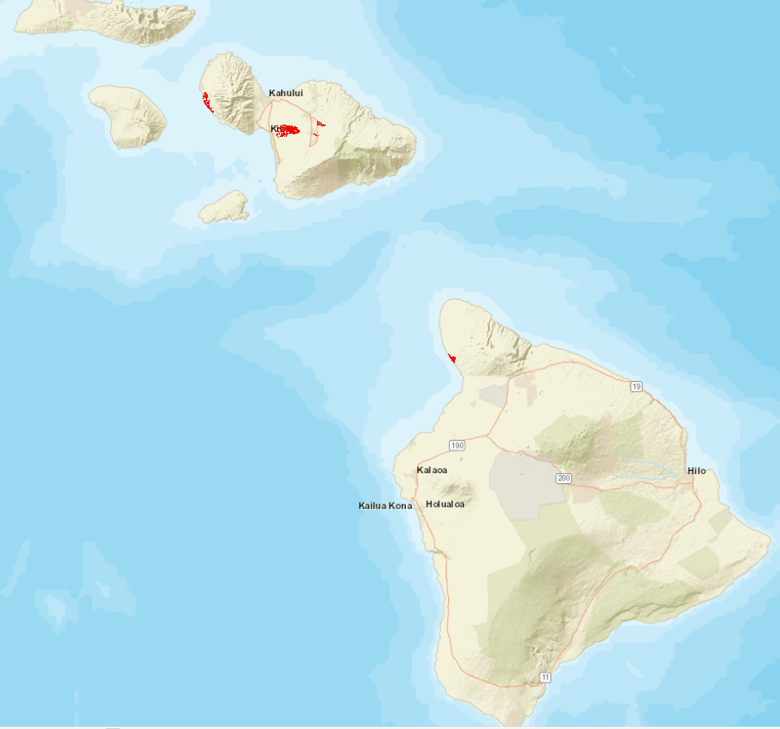
Land cover impacted by wildfires identified from Sentinel-2 MSI Normalized Burn Ratio (NBR) between August 8-18, 2023.
Legend
Wildfires

Slide 18
Land cover impacted by wildfires identified from Sentinel-2 MSI Normalized Burn Ratio (NBR) between August 8-13, 2023.
Crops | Acres Impacted | Acres State Total* | %
Diversified Crop | 155.53 | 65179.9 | 0.23
Rangeland | 3720.31 | 1267150 | 0.28
Pasture | 3160.89 | 764286 | 0.34
*Acres State Total calculated from land cover data products used in analysis.
Acres are not official NASS estimates.

