Slide 1
Summer 2022 Midwest Flooding Event
Assessment Period: July 26-August 8, 2022
Publication Date: August 17, 2022
USDA NASS
Disaster Monitoring Team

Slide 2
Event Summary
Greater St. Louis Area, Missouri, Illinois, Kentucky
Late July/Early August 2022 (July 26-30, 2022)
Historic Flash Flooding (https://storymaps.arcgis.com/stories/9d10335079444c159966e0a28c90c4df)
Described as a complex of training thunderstorms set up roughly along the I-70 corridor in Missouri and I-64 corridor in Illinois, and into Kentucky. These thunderstorms, at times, caused rainfall rates in excess of 4"/hr across complex terrain that led to widespread devastating impacts in the region (https://www.weather.gov/lsx/July262022Flooding, https://www.weather.gov/jkl/July2022Flooding, https://weather.com/photos/news/2022-07-26-st-louis-missouri-flood)

Slide 3
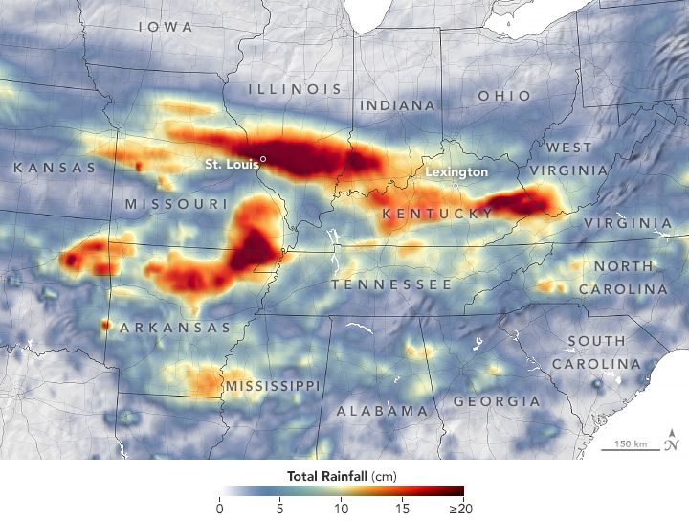
Event Summary
Rainfall totals throughout the Midwest from July 25-31, 2022 (https://earthobservatory.nasa.gov/images/150156/extreme-rainfall-leads-to-midwest-flooding).

Slide 4
PRISM Climate Group Data
4
Offers an "early glimpse" version of precipitation data from the current month
The datasets are modeled using climatologically-aided interpolation (CAI), which uses the long-term average pattern (i.e., the 30-year normals) as first-guess of the spatial pattern of climatic conditions for a given month or day
Data supported by USDA RMA
Map provided by PRISM Climate Group: https://prism.oregonstate.edu/mtd/

Slide 5
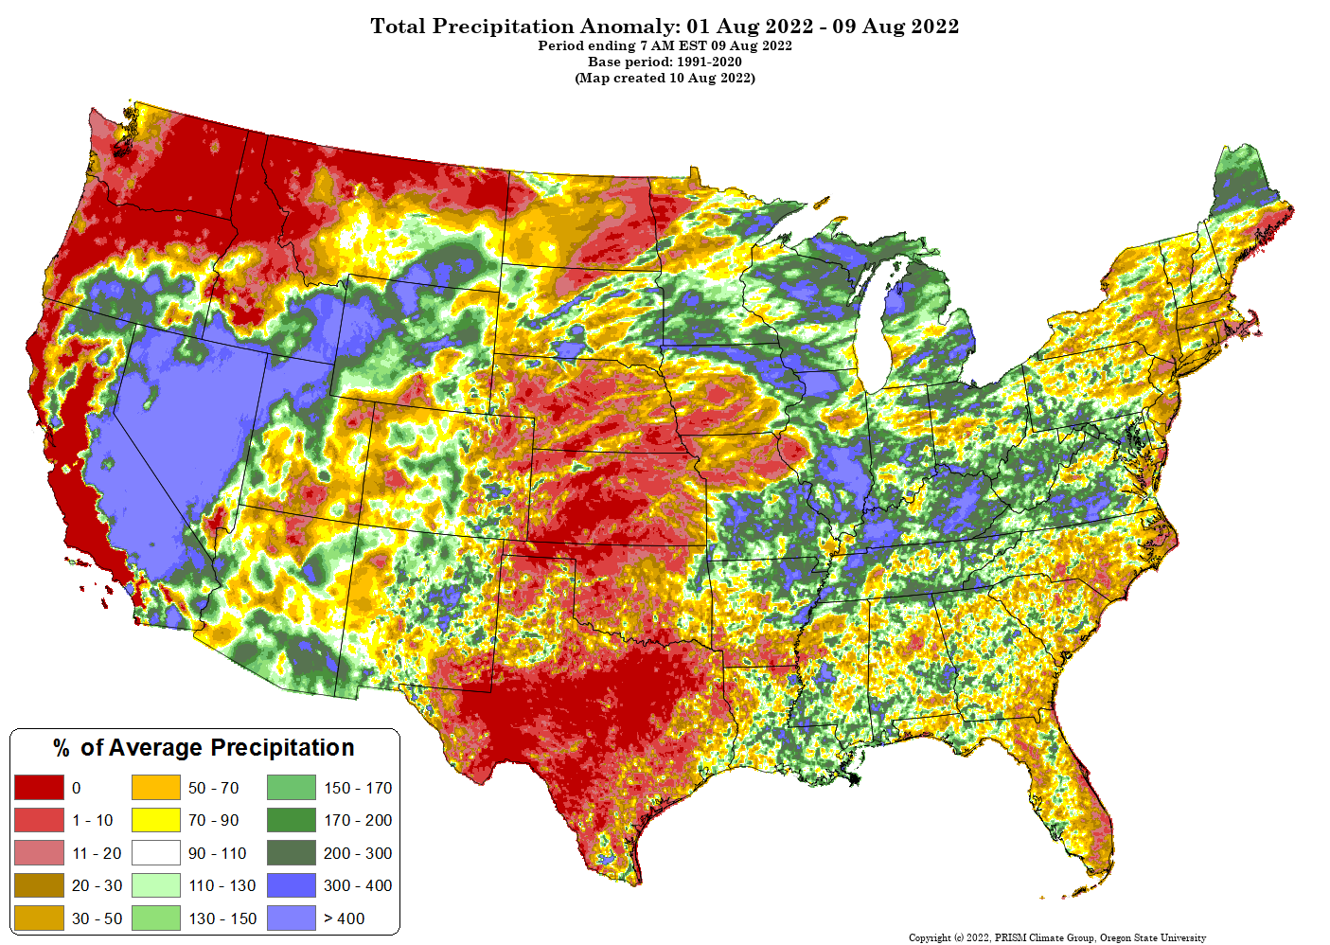
Map provided by PRISM Climate Group: https://prism.oregonstate.edu/mtd/

Slide 6

Sub Soil Moisture Anomaly
The soil moisture anomaly (SMA) in CropCASMA is a measure of deviation of the current soil moisture value from the "normal" soil moisture level, which is represented by a historical average soil moisture value (from 2015 to current).
The SMA of a given location is defined by the following formula:
where SM and SMm denote current soil moisture value and the historical average soil moisture value of a given location.
Soil moisture anomaly above 30% could be considered very abnormal, which means there is 30% more soil moisture than normal conditions.
Crop-CASMA: https://nassgeo.csiss.gmu.edu/CropCASMA/

Slide 7
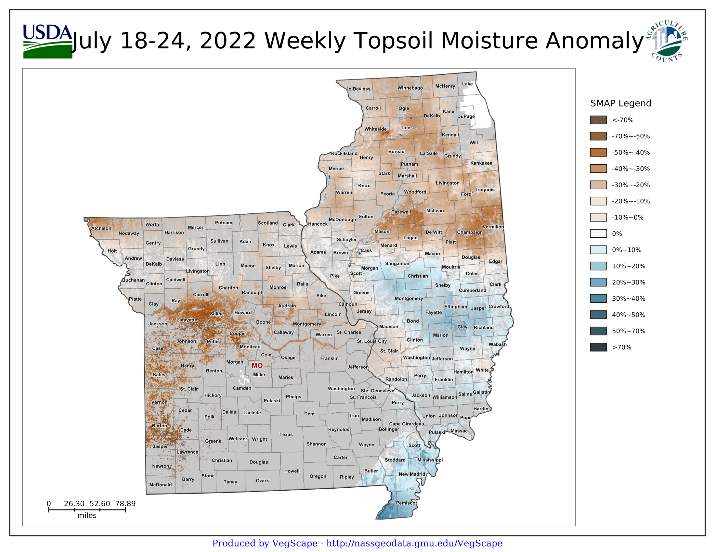

Slide 8
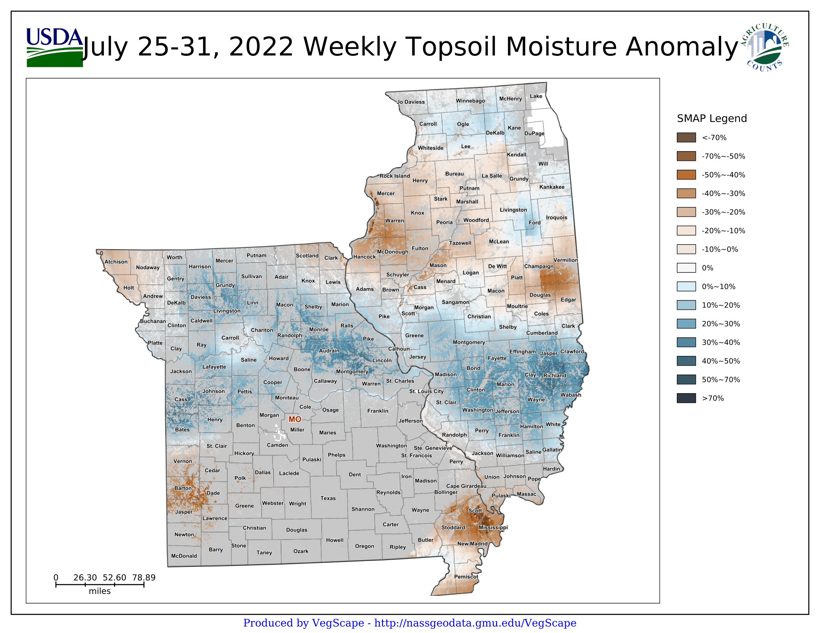

Slide 9
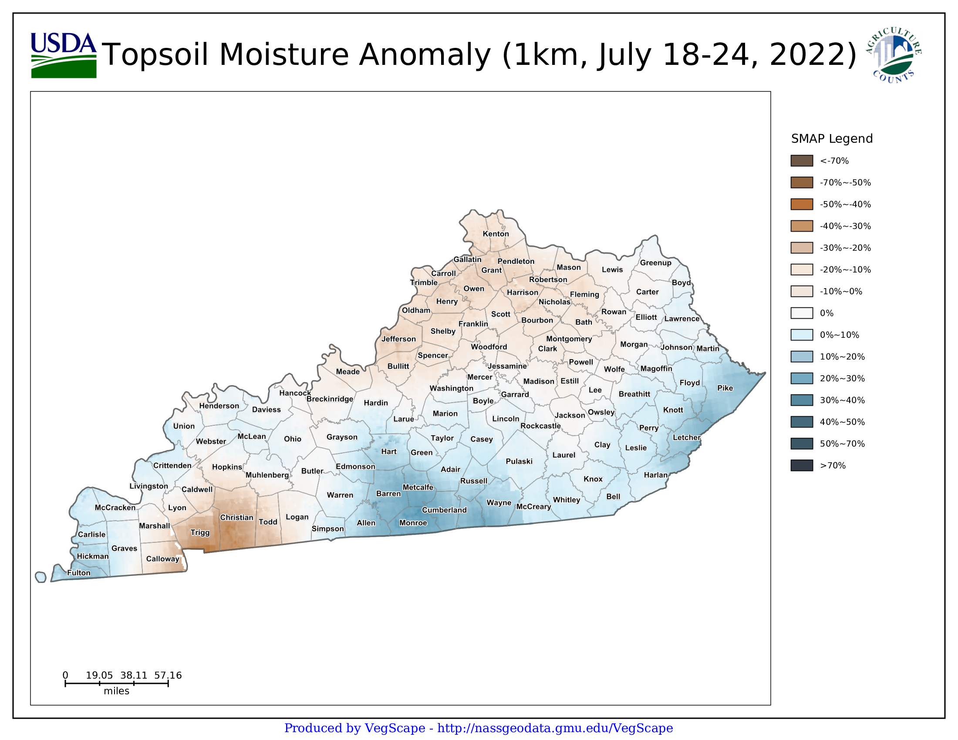

Slide 10
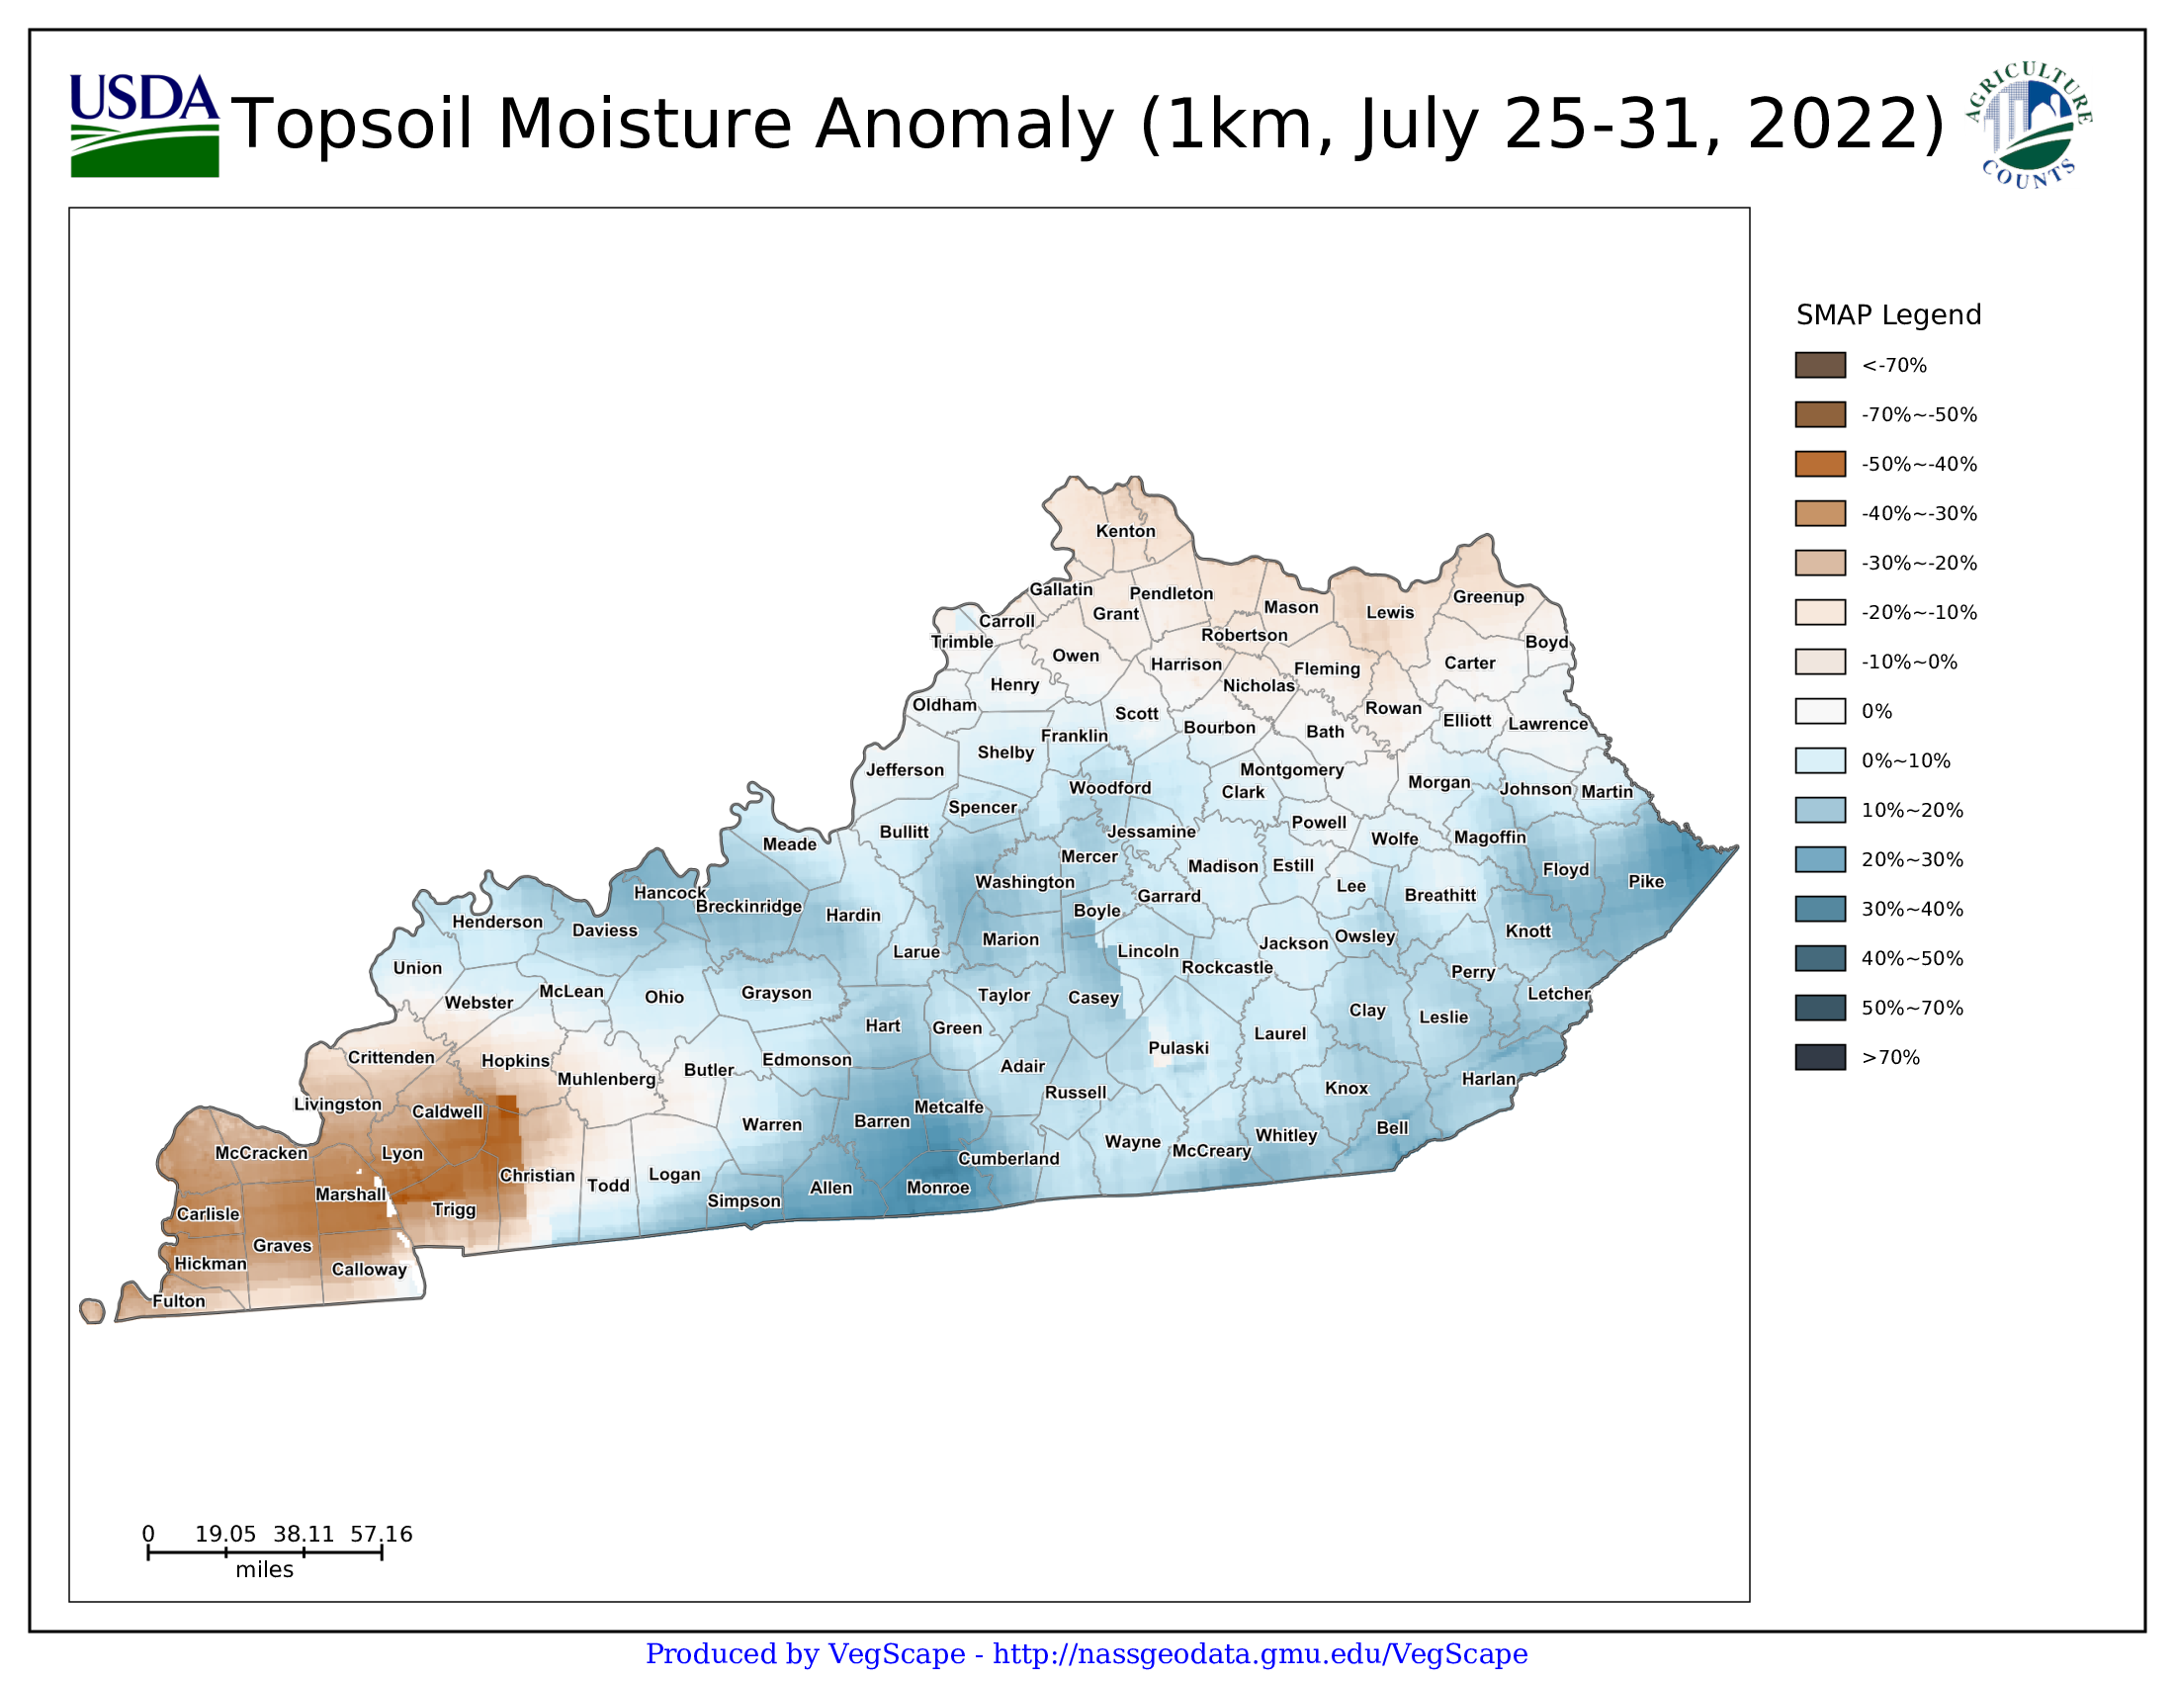

Slide 11
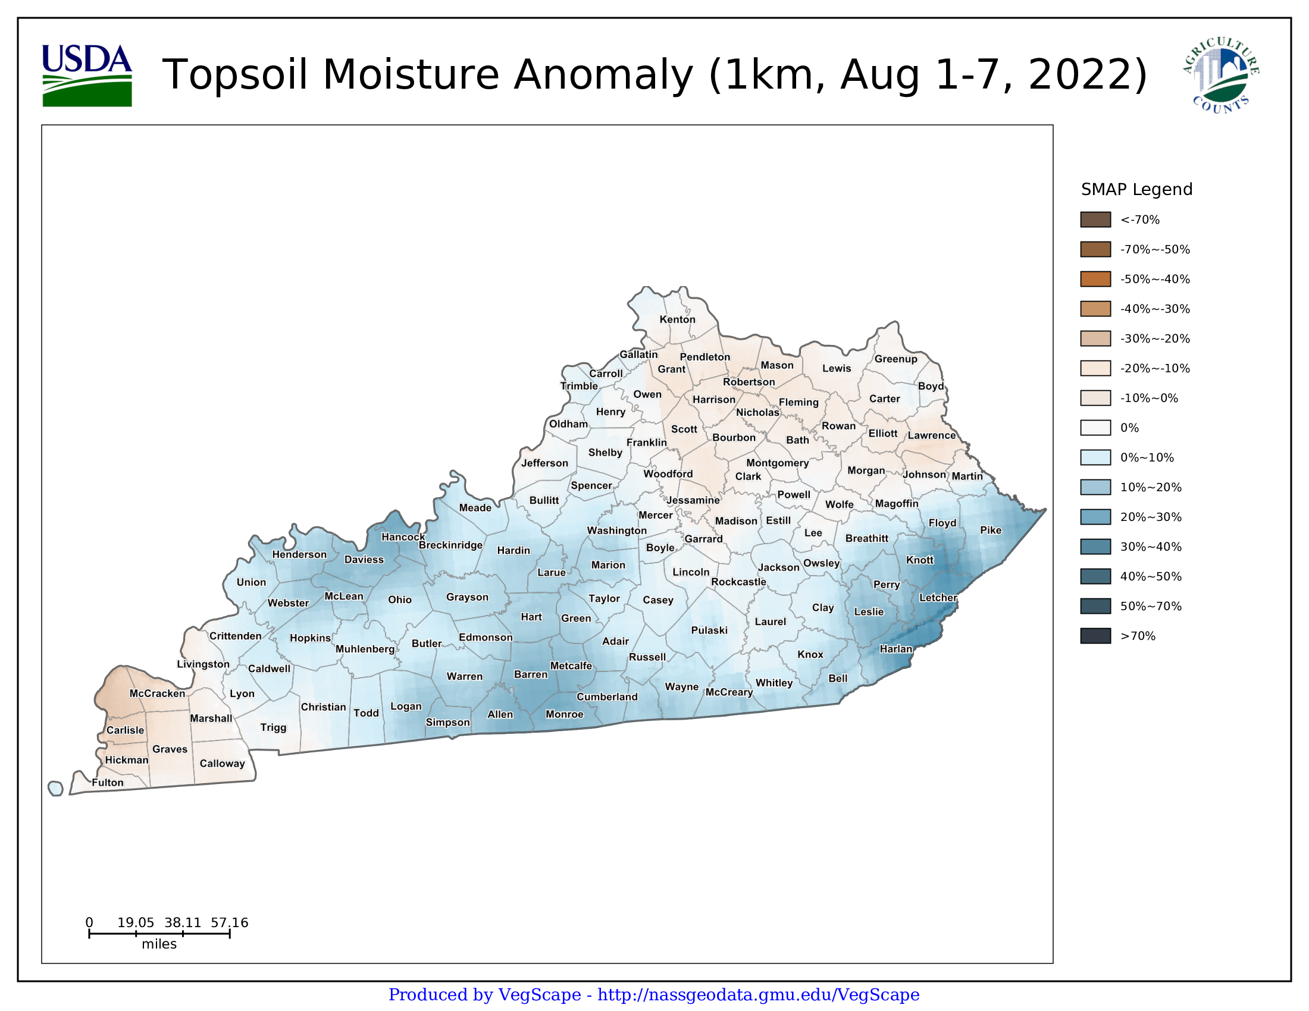

Slide 12
Inundation Analysis – St. Louis Area

Slide 13
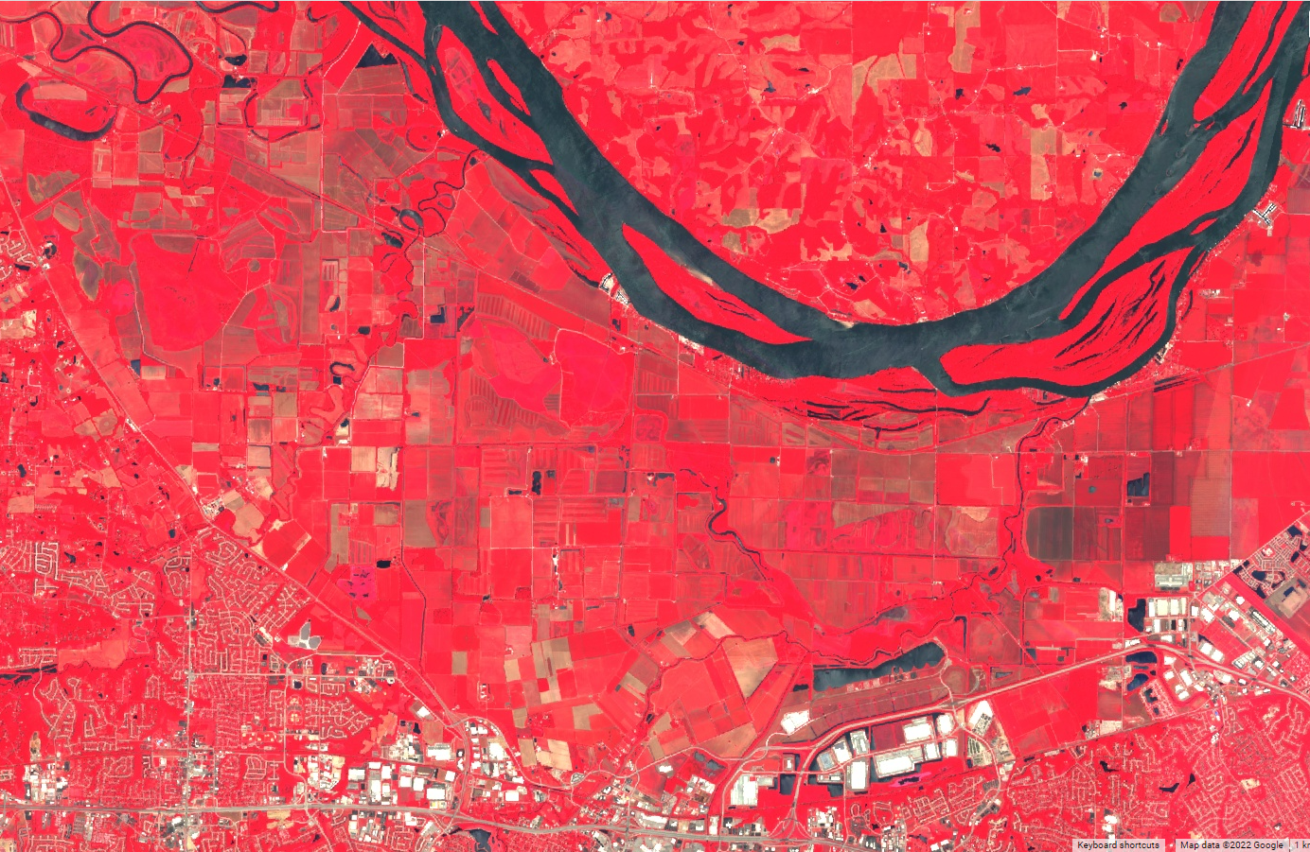
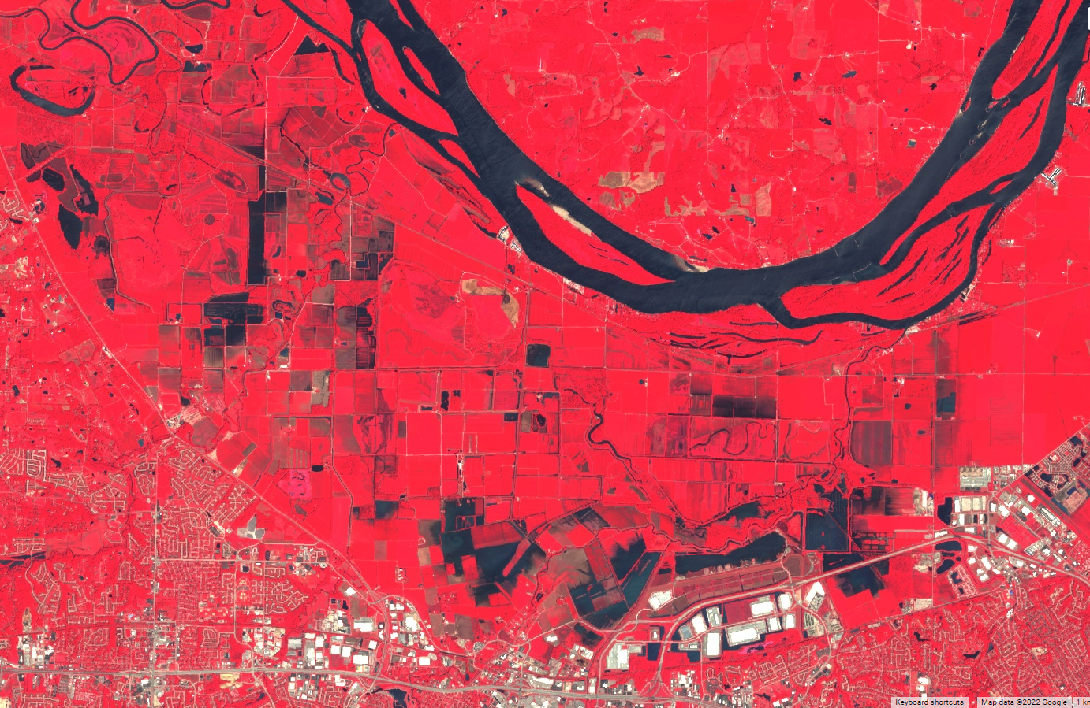
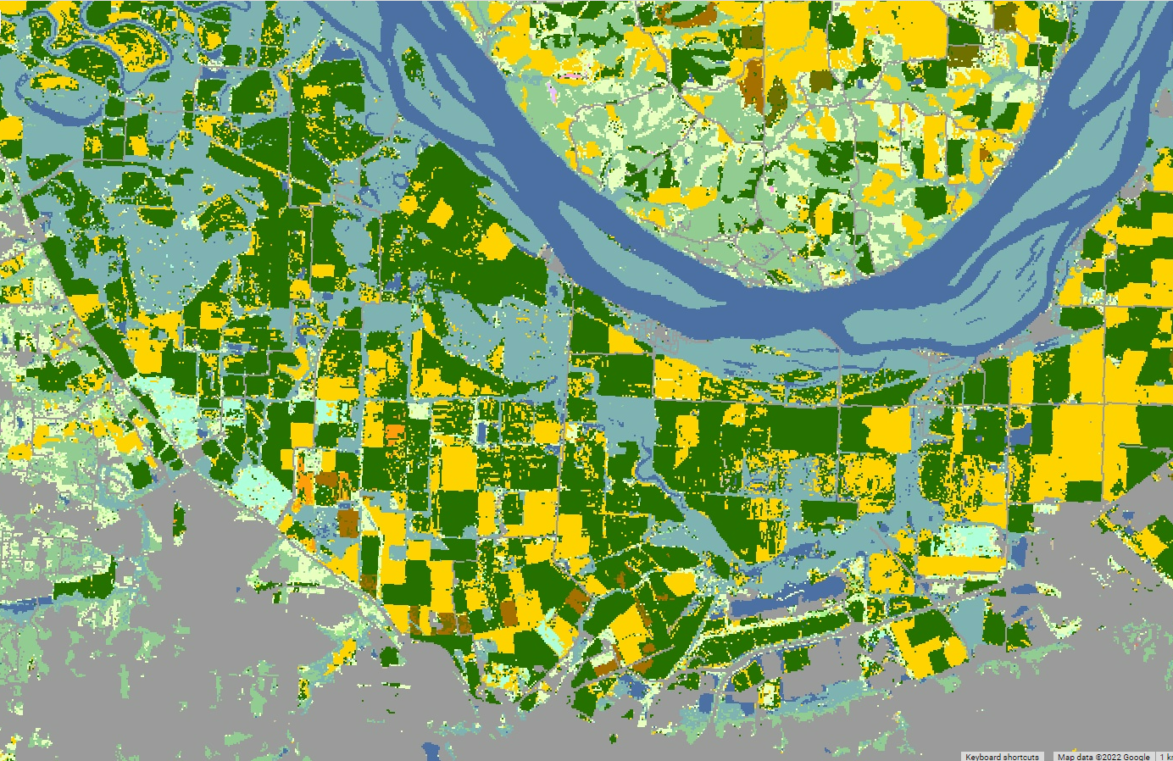
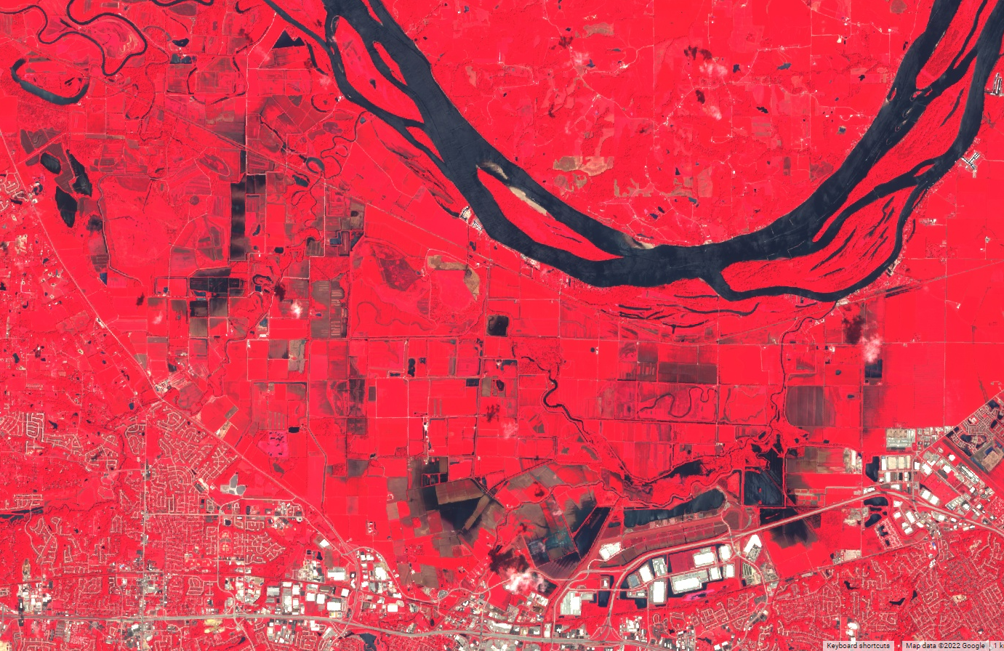
St. Charles County, MO
Jun 4 – Jul 22, 2022
Aug 1, 2022
NASS CDL 2021
Aug 6, 2022
Sentinel-2 MSI Images (optical imagery)

Slide 14
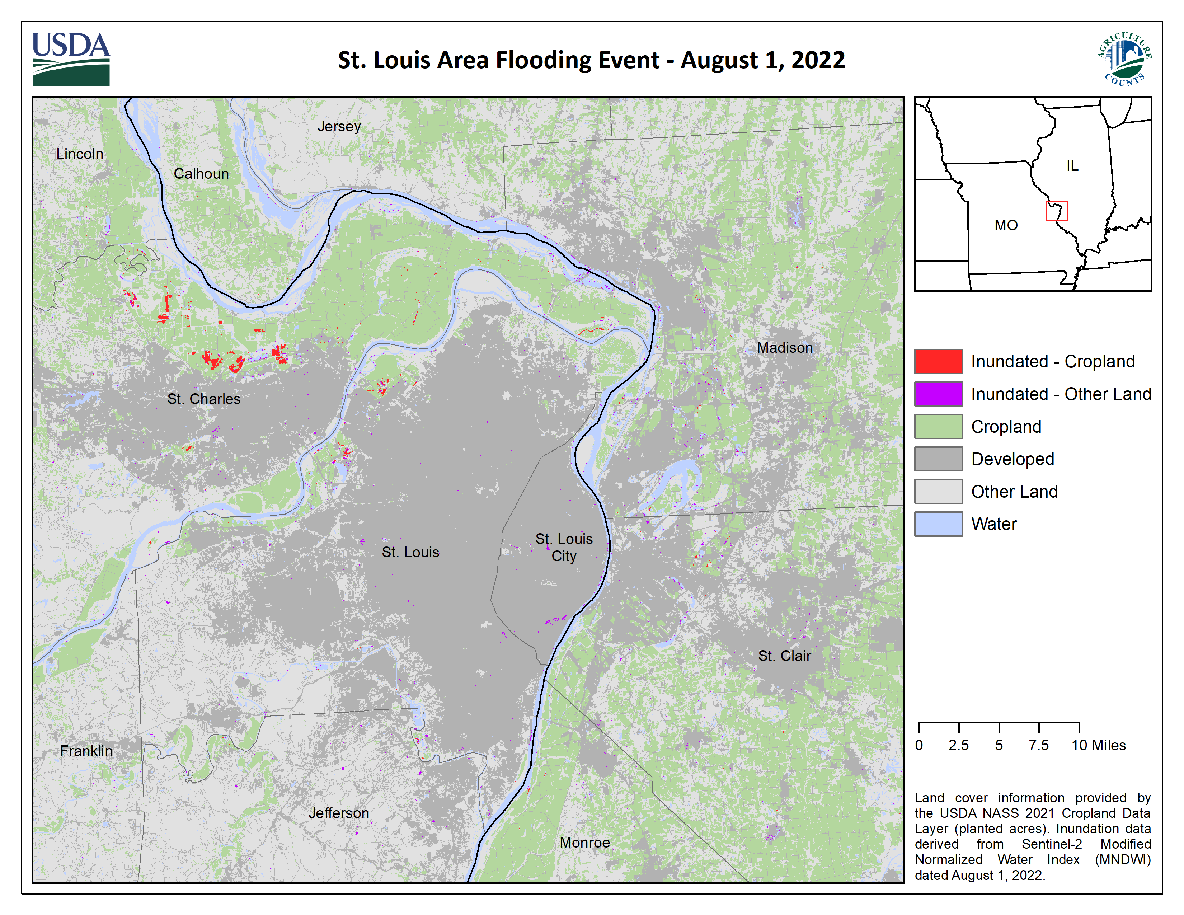

Slide 15
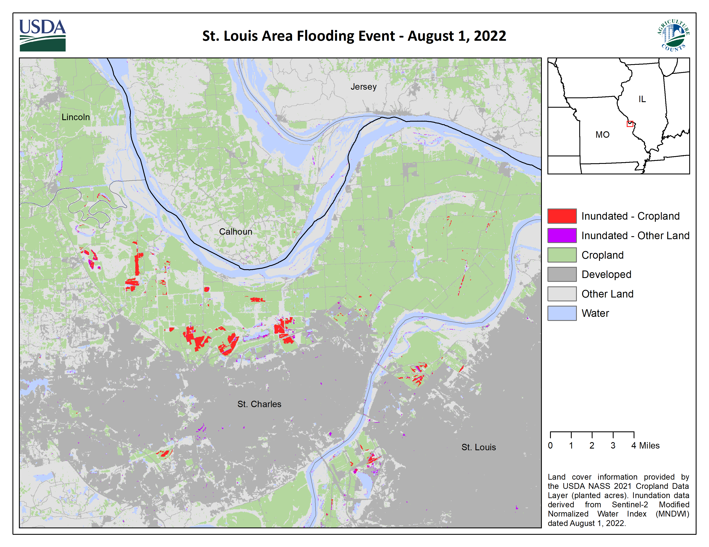

Slide 16
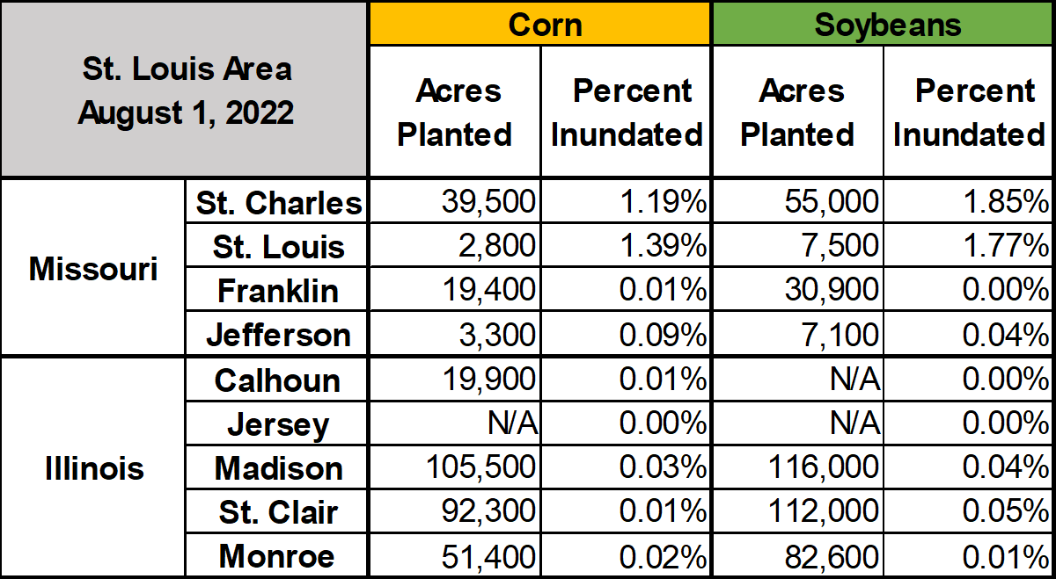
Inundated Cropland – St. Louis Area
Acres planted are official NASS estimates for acres planted of corn and soybeans in 2021. Percent inundated derived from Sentinel-2 Modified Normalized Water Index (MNDWI) dated August 1, 2022 and the 2021 Cropland Data Layer (acres planted).

Slide 17
Inundation Analysis – Southern Illinois

Slide 18
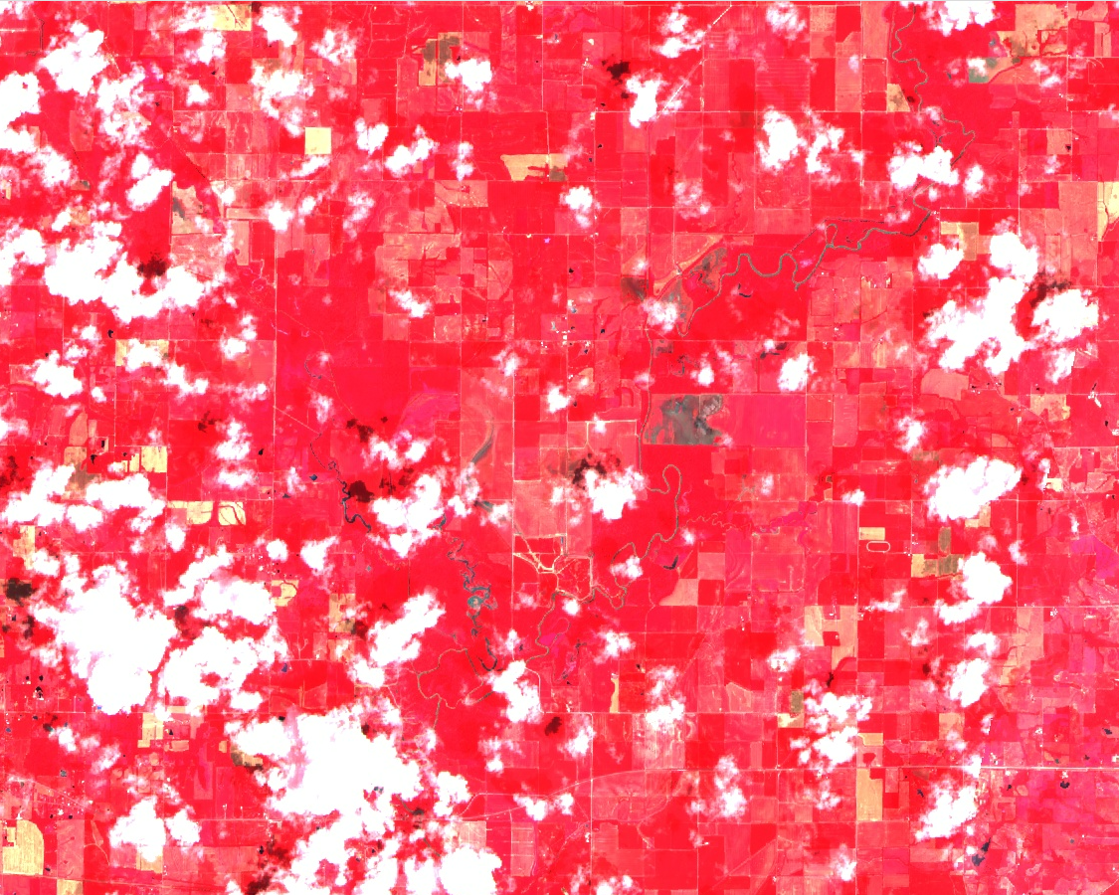
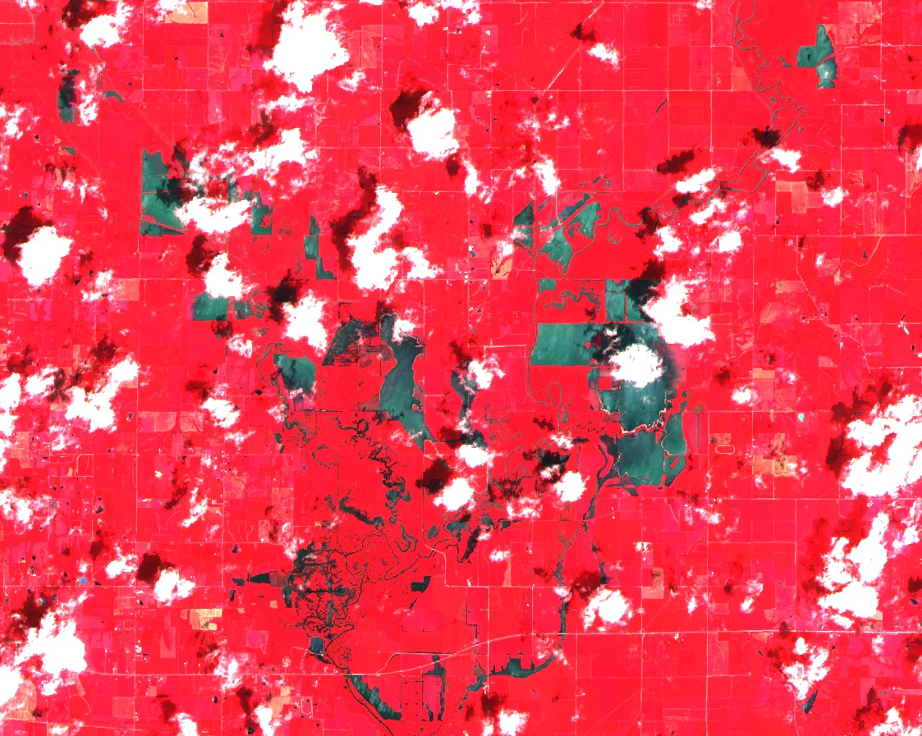
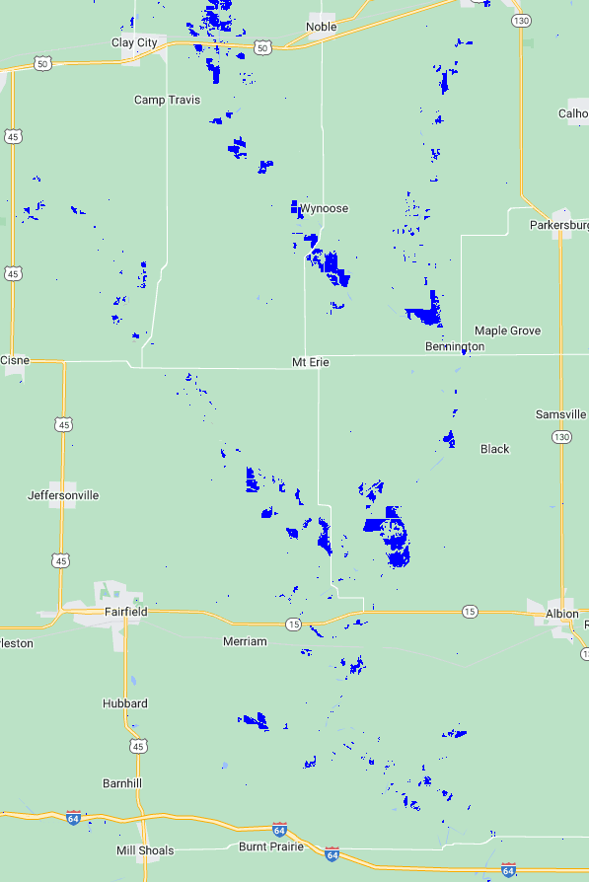
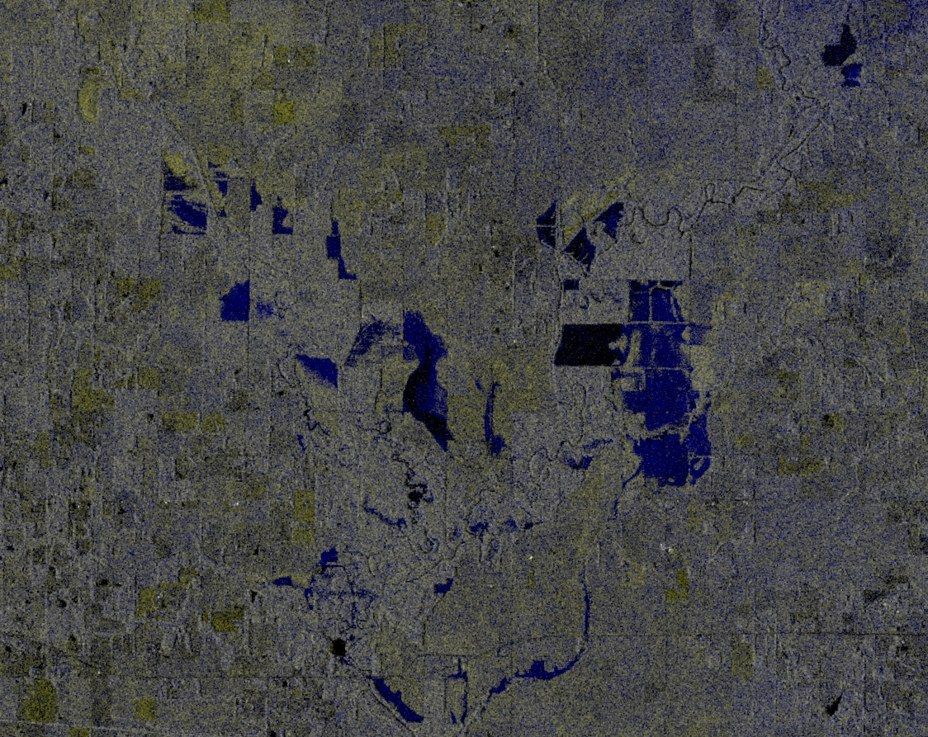
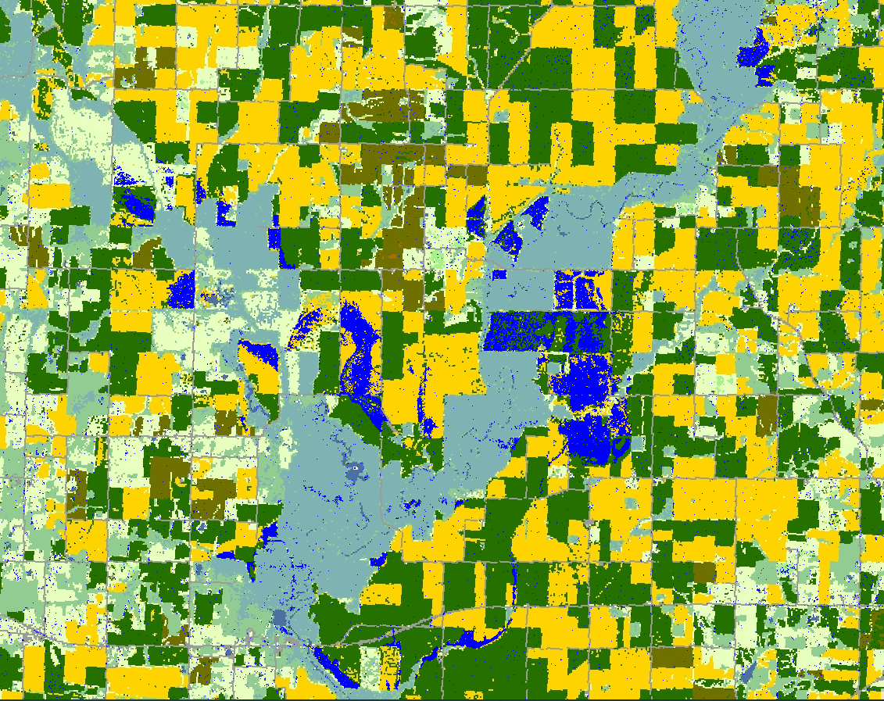
Wayne County, IL
Before
After
Sentinel-2 MSI images (median of Jul 01 – 21, 2022)
Sentinel-2 MSI images (Aug 3, 2022)
NASS CDL 2021
Sentinel-1 SAR anomaly (Aug 1, 2022)
Inundated corn and soybeans (blue) detected from Sentinel-1SAR and Sentinel-2 MSI images

Slide 19
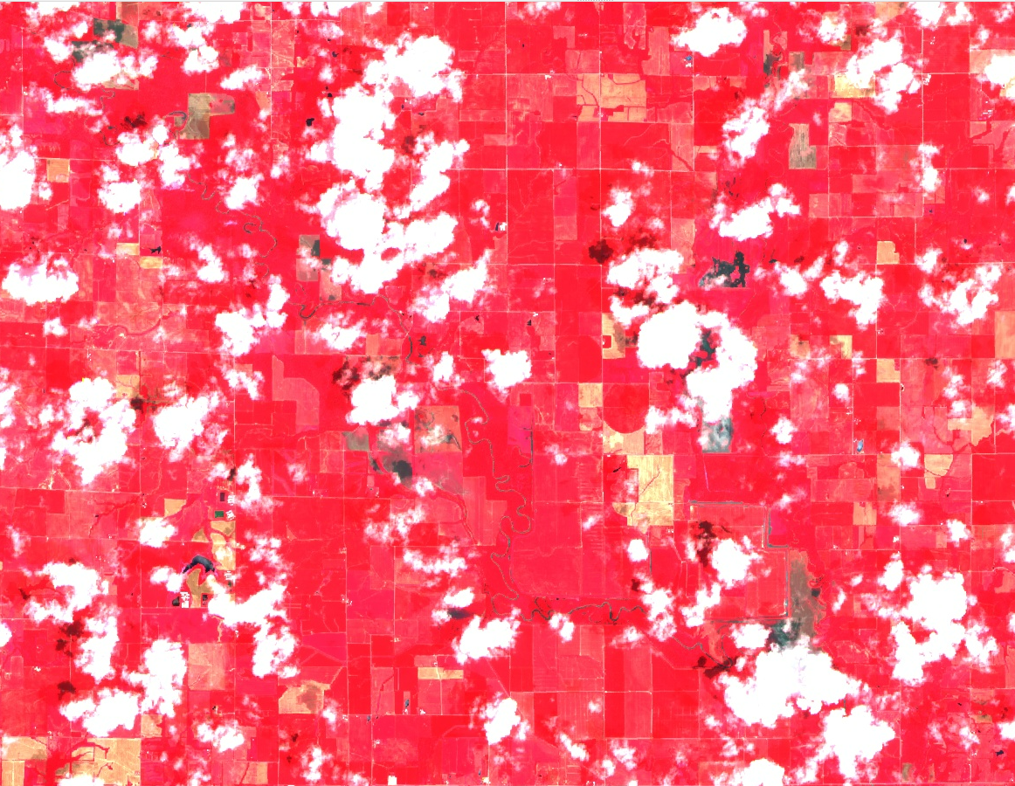
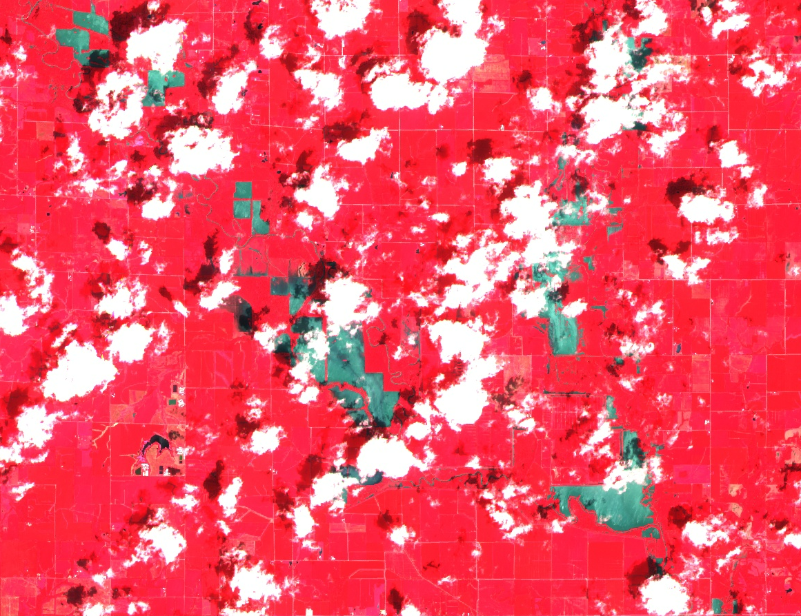
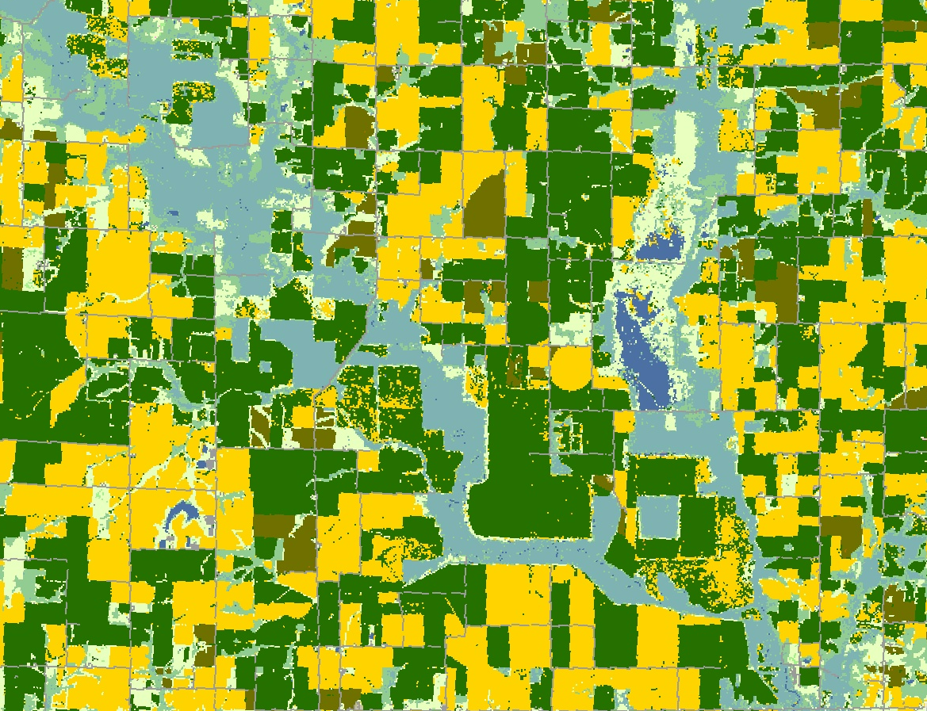
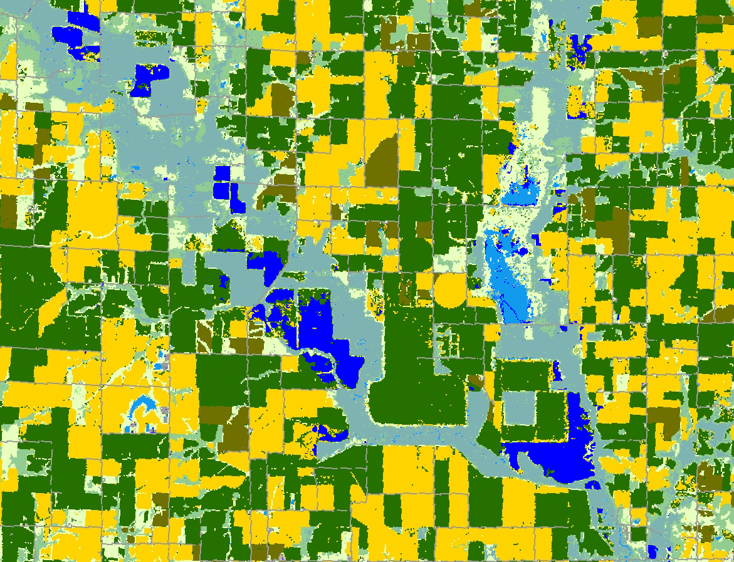
Wayne County, IL
Before
After
Sentinel-2 MSI images (median of Jul 01 – 21, 2022)
Sentinel-2 MSI images (Aug 3, 2022)
NASS CDL 2021
Inundated corn and soybeans (blue) detected from Sentinel-1SAR and Sentinel-2 MSI images

Slide 20
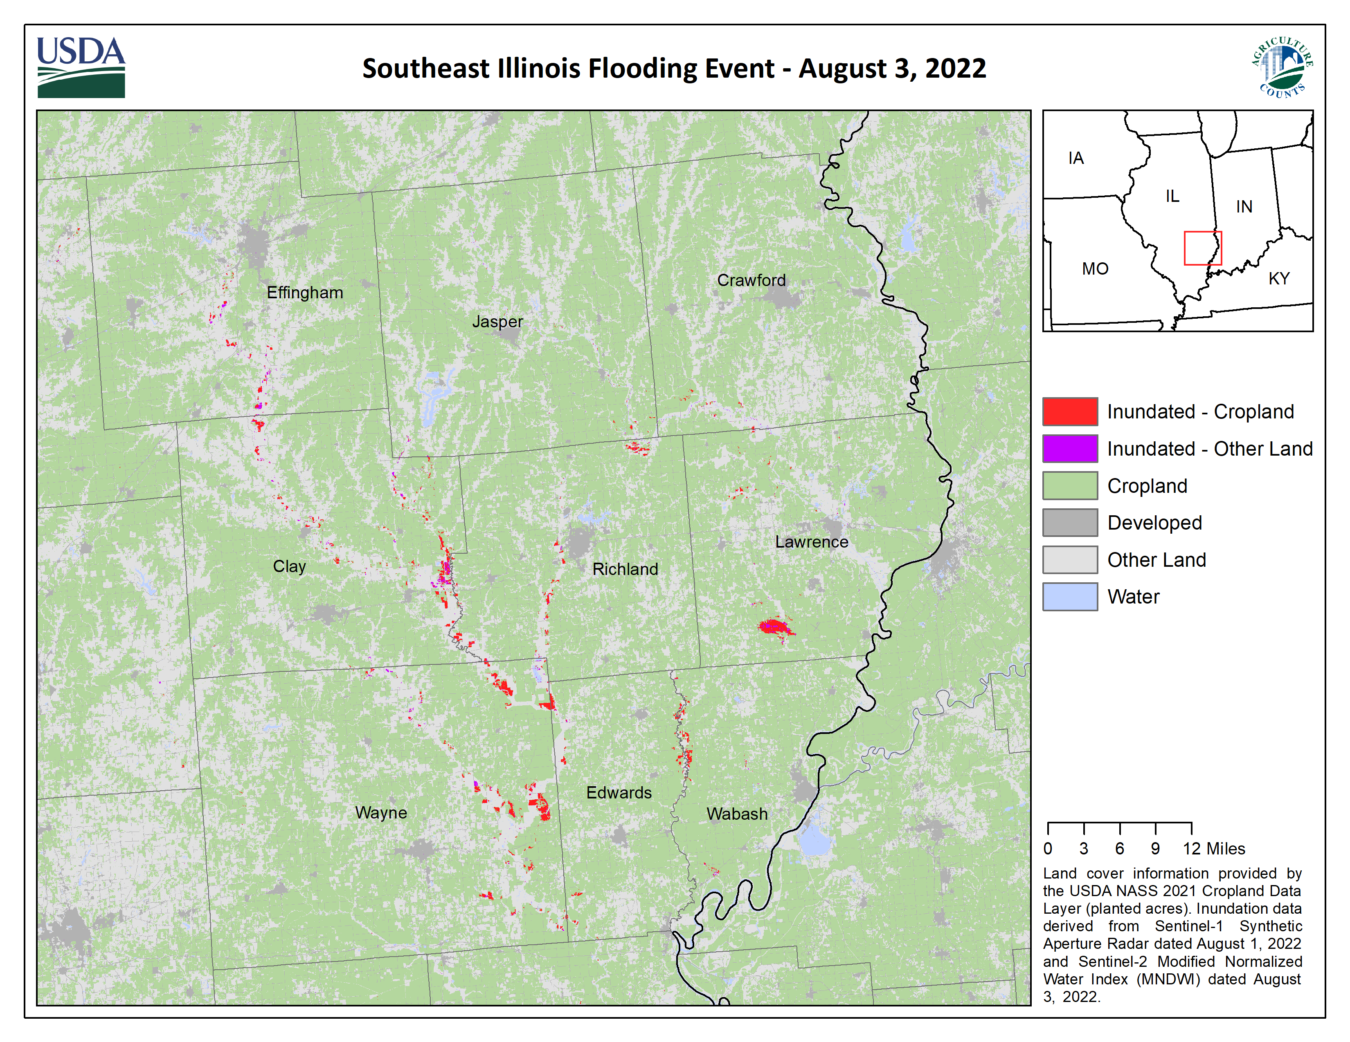

Slide 21
Inundated Cropland – Illinois
Acres planted are official NASS estimates for acres planted of corn and soybeans in 2021. Percent inundated derived from Sentinel-2 imagery dated August 1-3, 2022 and the 2021 Cropland Data Layer (acres planted).

Slide 22
Inundation Analysis – Southwest Kentucky

Slide 23
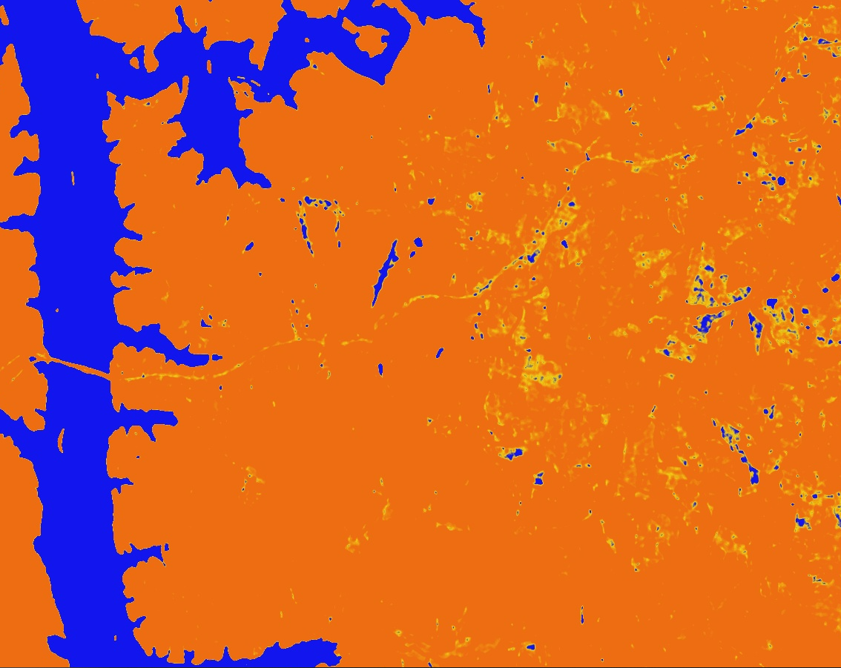
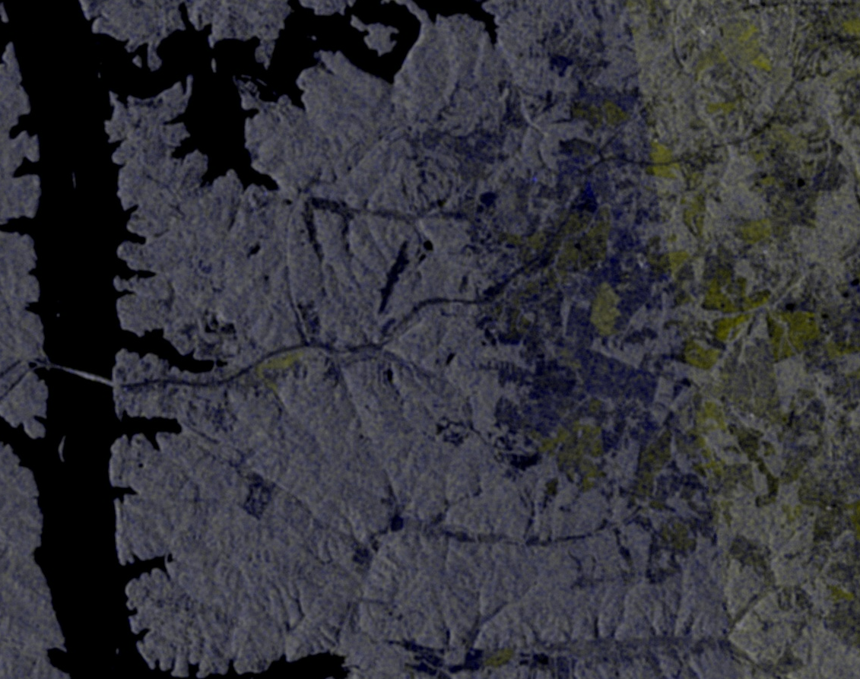
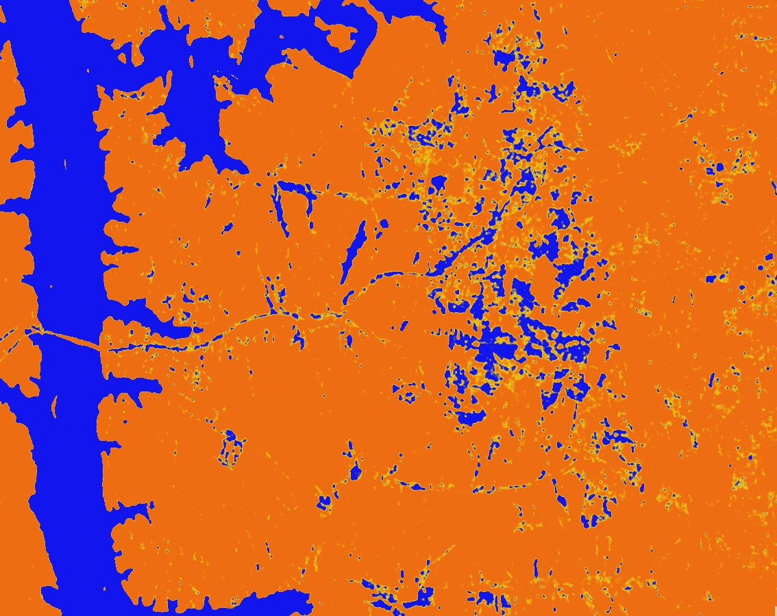
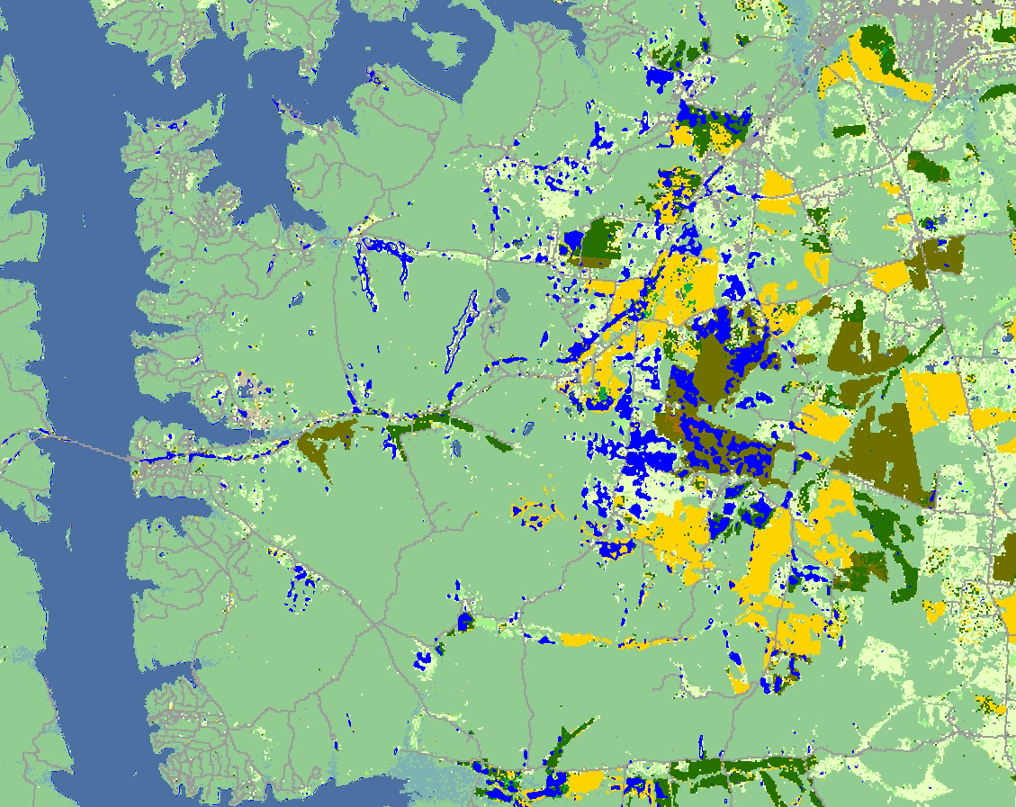
Trigg County, KY
Median SWI of Jun 2 - Jul 22, 2022
Sentinel-1 SAR anomaly (Aug 1, 2022)
Floods (blue) were detected from Sentinel-1 images of July 27 and Aug 1, 2022, in croplands near Cumberland River, Kentucky. Affected crops may include soybeans, double crop winter wheat/Soybeans, and corn.
Min SWI Jul 25 - Aug 8, 2022

Slide 24
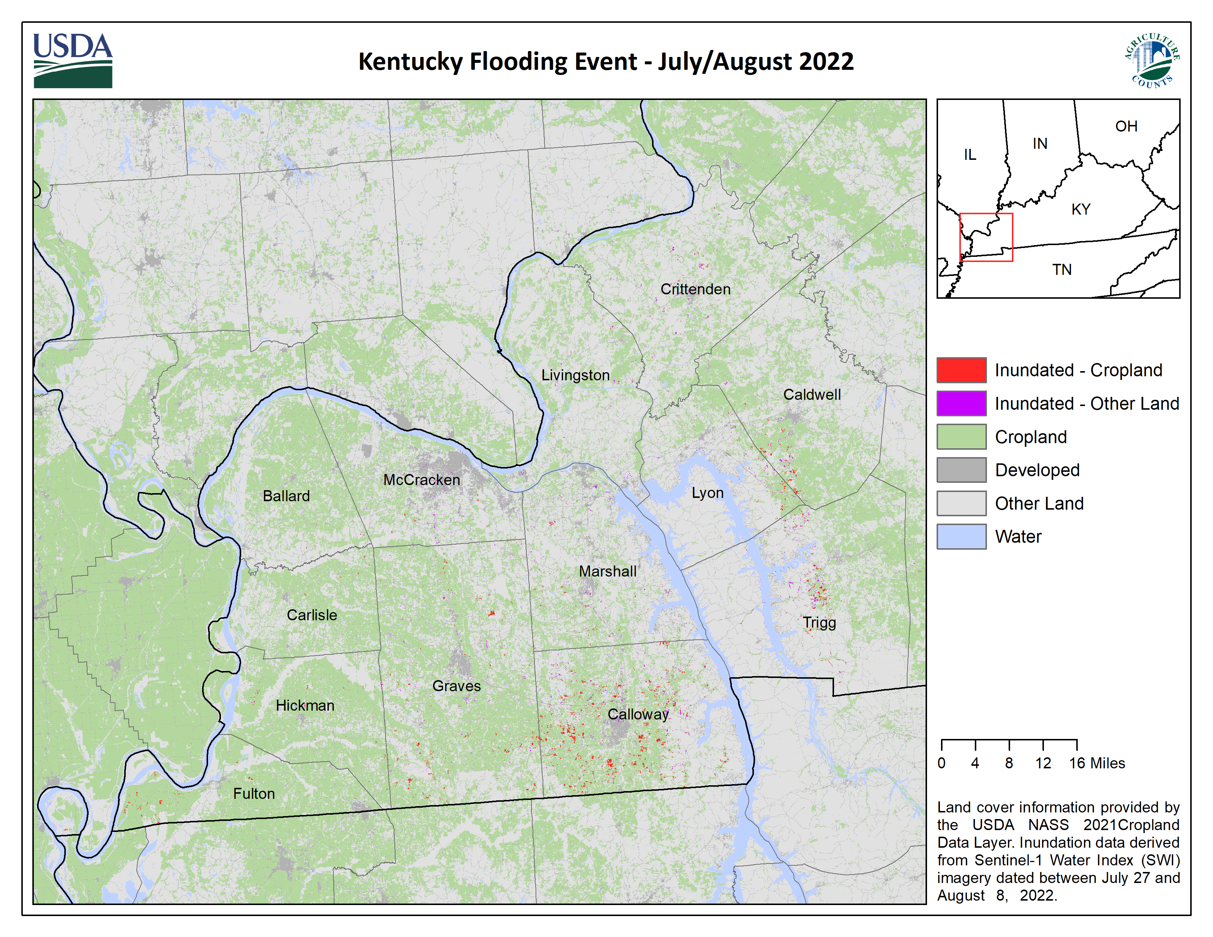

Slide 25
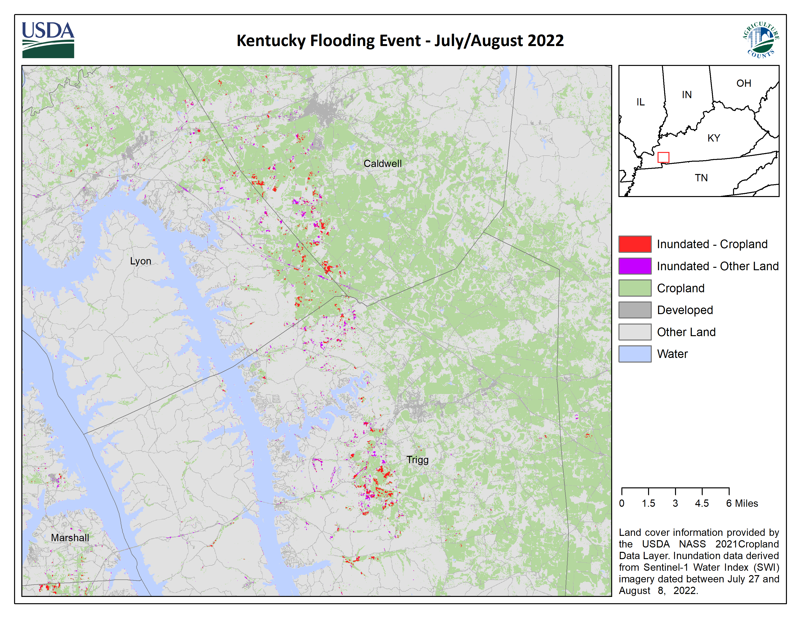

Slide 26
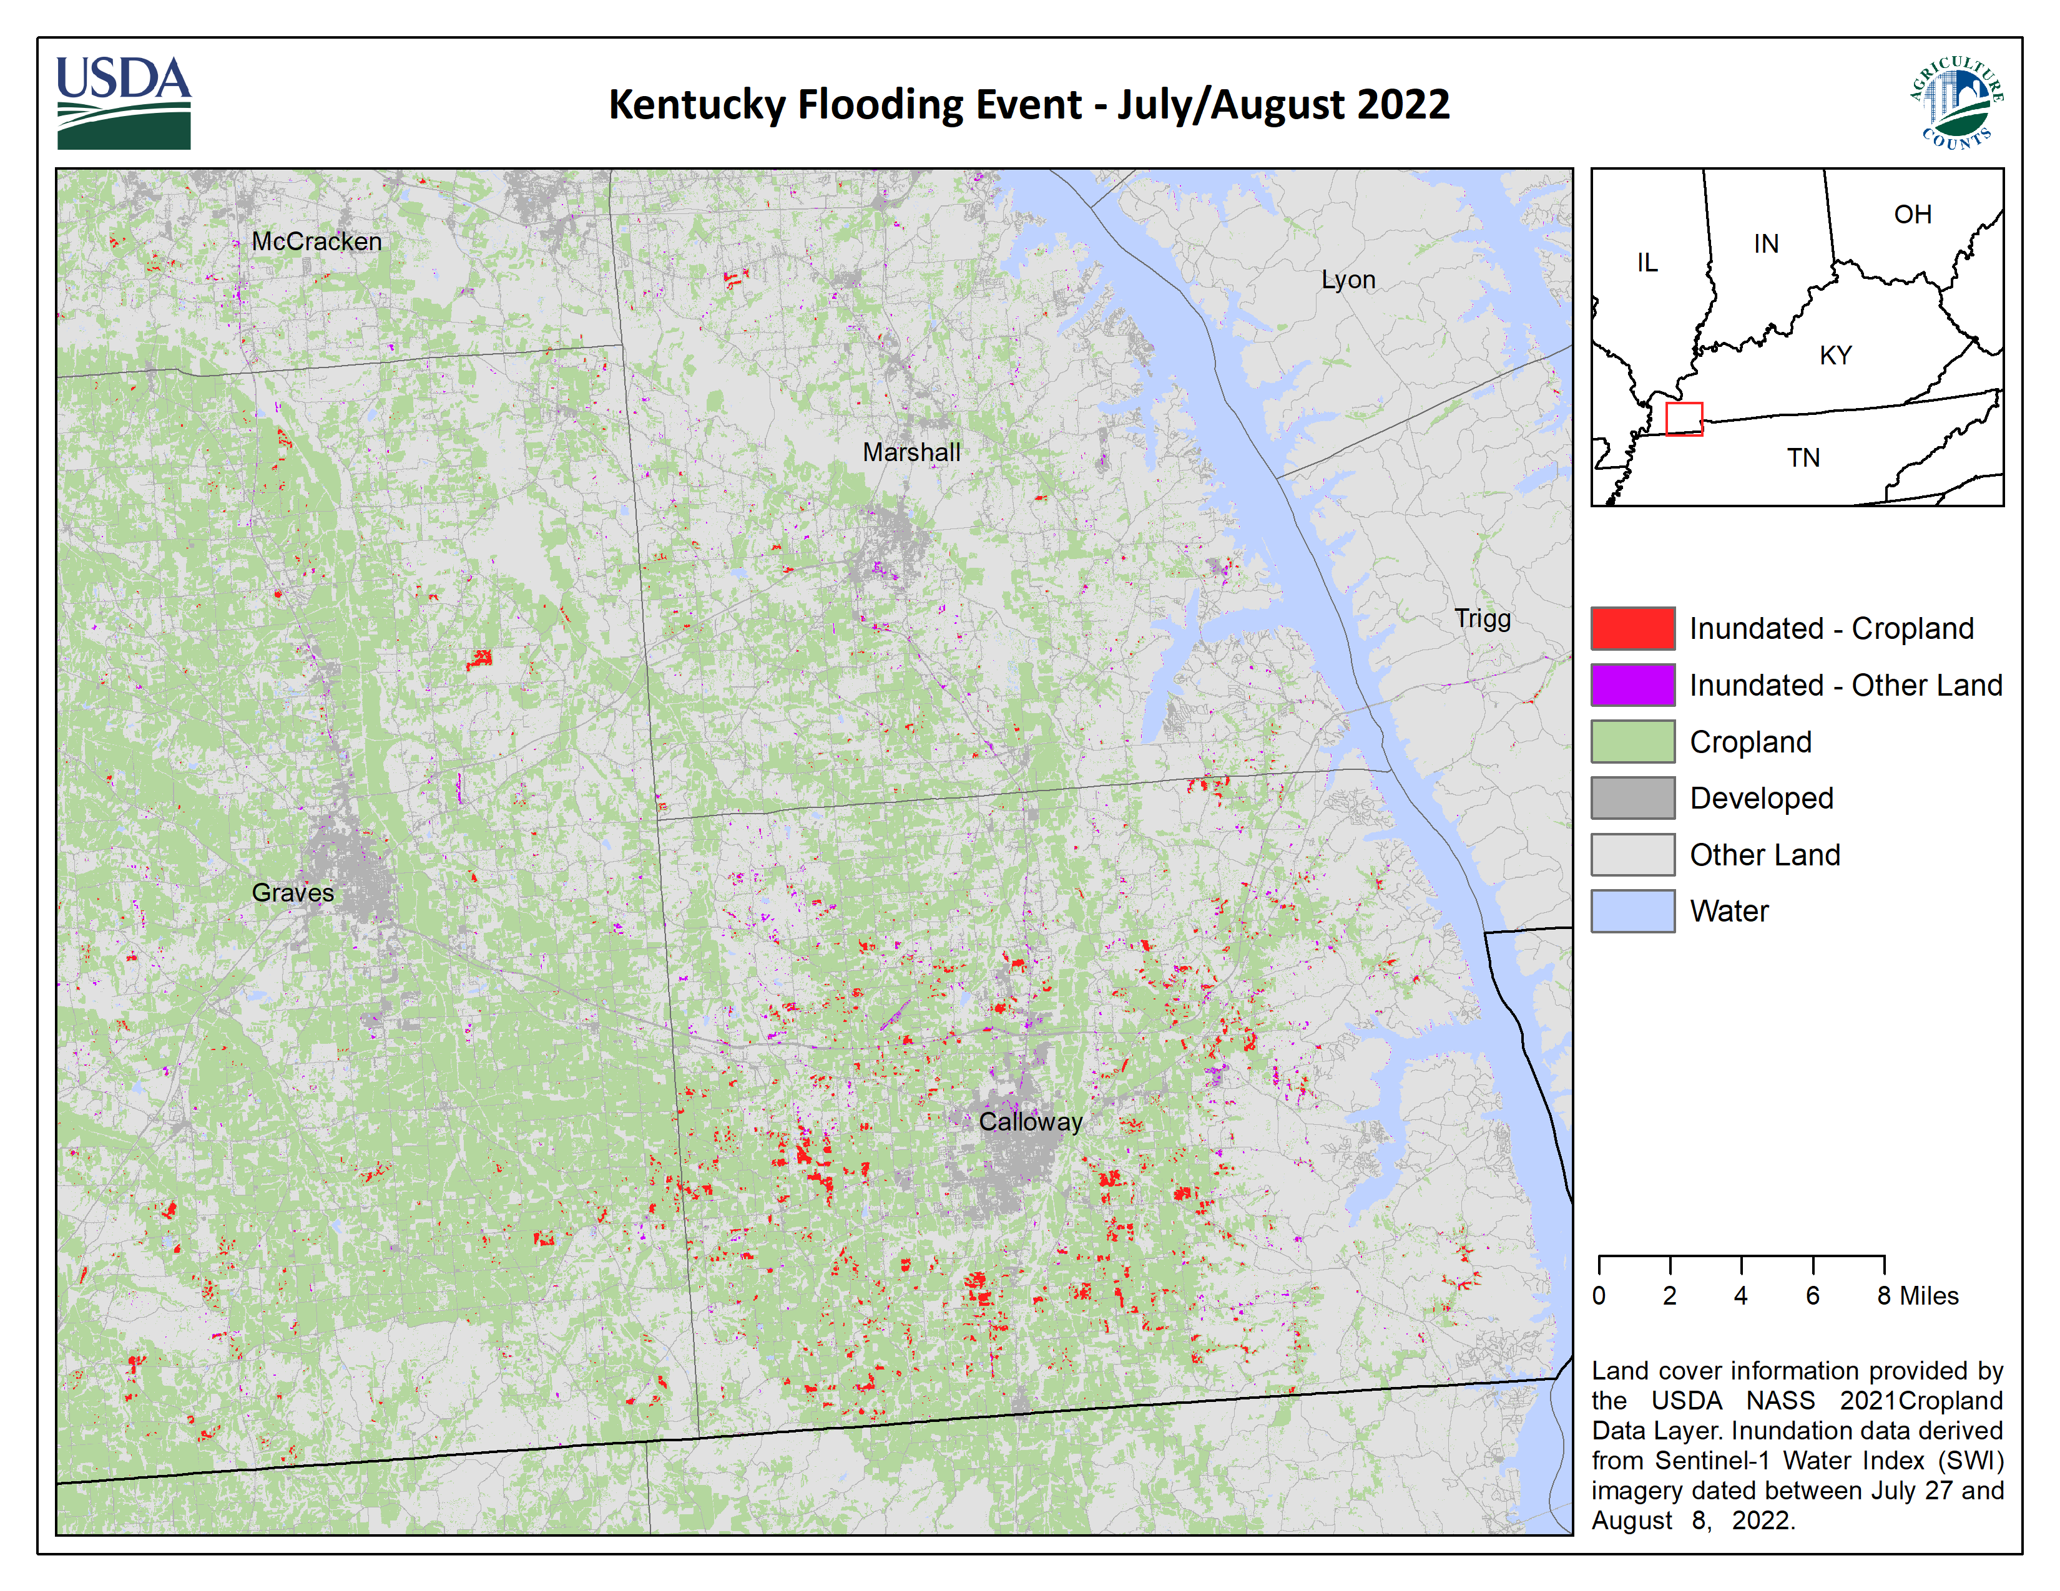

Slide 27
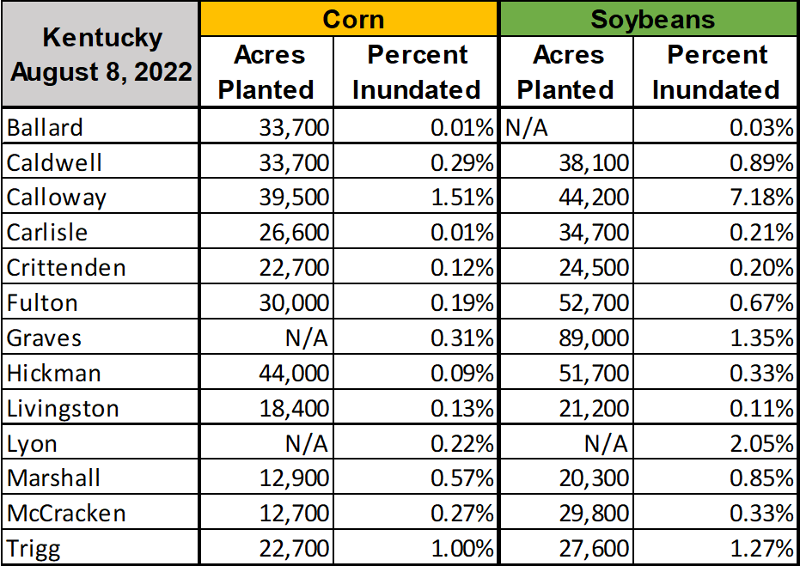
Inundated Cropland – Kentucky
Acres planted are official NASS estimates for acres planted of corn and soybeans in 2021. Percent inundated derived from Sentinel-1 Water Index (SWI) imagery dated between July 27 and August 8, 2022. and the 2021 Cropland Data Layer (acres planted).

